Slide 1
2014 Round of Monitoring Development Effectiveness in Health
Summary of Findings
(to be validated)
02 December 2014

Slide 2
Key findings
Notes:
4 out of 7 behaviours measured
Not procurement / SSC / TA

Slide 3
Notes:
Key messages – we take you through them one by one
Overall picture not bad: 6 X GREEN (target achieved) 5X Some activity 3 X RED LIGHT
Country & DP performance quite good related to CRF ; CSO engagement; measuring results ; strengtehning accountability.
Country performance > DP performance fir financial indicators
Interesting:
IHP+ membership associated with better country performance
Country & DP performance are correlated
PRESENTATION covers
Country performance
Group Accountability indicators: results framework / CSO / measuring results / mut accountability
Group Financing indicators
DP performance
Group Accountability indicators
Group Financing ndicators

Slide 4

Performance of
24 partner countries
Notes:
24 participating countries
24/35 IHP+ partner countries = 69%
Africa = winner!

Slide 5
Brief overview of participating countries
Notes:
Varied sample of countries!
From 250 to 25 USD / Capita
From 99% domestic financing to almost 60% external financing

Slide 6
  Partner countries continue to deliver on commitments to establish health sector strategies, measure results and strengthen accountability (1)
Figure 1: Proportion of countries with Country Results Frameworks
UP
Figure 2: Number of countries with CSO involvement in each of the five health policy processes
LEVEL
Notes:
4 indicators:
The establishment of a comprehensive health sector results framework
The engagement of civil society in health policy and planning processes
The joint assessment of a national health sector strategy that included targets and budgets
The implementation of policies and procedures that foster mutual accountability
Figure 1:
Since the start of monitoring IHP+ performance, an increasing number of partner countries have established a comprehensive country results framework
The 17 countries that had participated in previous monitoring rounds were more likely to have a country results framework in place than the seven countries that participated for the first time.
Figure 2:
Ministries of Health reported on the participation of civil society organisations (CSOs) in five health policy and planning processes
The last process was measured for the first time in this monitoring round.
The government-reported participation of CSOs in health policy and planning processes continued to be as high as reported in 2010/11 with the exception of participation in budget development and resource allocation, where a 50% decrease was recorded.

Slide 7
  Partner countries continue to deliver on commitments to establish health sector strategies, measure results and strengthen accountability (2)
Figure 3: Proportion of countries with jointly assessed national health strategies
UP
Figure 4: % of countries that have established mutual accountability processes (N=24)
LEVEL
Notes:
Figure 3:
Among all 24 countries, the proportion with jointly assessed strategies increased by 20% since the 2010/11 monitoring round.
The increase was 60% among the 17 countries that had participated in previous monitoring rounds
Figure 4:
Five national processes were monitored to assess the policy environment for mutual accountability
Two thirds of the 24 participating countries reported that at least four of the five mutual accountability processes were in place.
The most common process was the establishment of targets for effective development cooperation, the least common was the public communication of results
All five processes were more frequently reported by the 17 countries that participated in previous rounds than by the countries that had joined for the first time.

Slide 8
  Partner countries continue to deliver on commitments to establish health sector strategies, measure results and strengthen accountability (3)
Figure 6: Aggregate scores of participating countries on 4 accountability indicators
Notes:
Figure 5:
In comparison to 2010/11 the number of countries that met the target criteria of having established at least four processes decreased slightly, however the data are not strictly comparable because more stringent criteria were applied in the 2014 monitoring round
Figure 6:
The average score obtained by the 24 participating countries for the four accountability indicators was just below 3 indicating 74% achievement.
Eight countries had a score below the average.
They tended to be newer members of the IHP+ with a median membership history of 2.5 years compared to the other 16 counties who had a median duration of membership of 5 years .

Slide 9
  Partner countries have improved the financing and to some extent financial management in the health sector (1)
Figure 7: Proportion of national budget allocated to health in 2013
UP
Figure 8: Government health sector budget execution in 2013
UP
Notes:
Three indicators were analysed to assess the progress of partner countries on meeting commitments to transparent and predictable health sector financing:
The proportion of the national budget allocated to the health sector and the level of execution of the budget
The predictability of health sector funding over the next three years through a rolling budget or a medium term expenditure framework (MTEF)
The strength of public financial management as assessed by the World Bank’s Country Policy and Institutional Assessment (CPIA) scale
Figure 7:
Since the 2010/11 monitoring round, partner governments increased the proportion of national budgets allocated to the health sector from an average of eight to ten percent.
Two countries (Togo and Burkina Faso) reached the targets for the Abuja commitment for Africa of 15%.
Figure 8:
The average level of budget execution remained virtually unchanged at 71%, but the number of countries that reached the target of 90% budget execution increased by 44% to 13/22
A word of caution
During consultations in the DRC, stakeholders remarked that the budget execution rate reported by the Ministry of Health is overestimated because it is calculated on expenditures of internal revenue funds and on-budget partner funds. The execution of the budget to be financed with internal revenue funds is habitually only in the region of 30% to 35% in DRC.

Slide 10
  Partner countries have improved the financing and to some extent financial management in the health sector (2)
Figure 9: Average scores of participating countries on 3 financing indicators
Notes:
12 countries with CPIA score above 3.5 => sufficiently robust public financial management systems
(WB CPIA database, no data for El Salvador)
Serial CPIA data published by the World Bank for 23 of the 24 participating countries show no change in the soundness of the public financial management systems from an average score of 3.17 in 2005 to 3.26 in 2013
For all 3 financing indicators together:
Some correlation between performance and duration of membership in IHP+, but weaker than for the mutual accountability indicators.
Stronger correlation of financial performance with the level of external funding of the health sector. This may be due to preferences by development partners to support countries with stronger national financial management, or countries with higher level of external funding may invest more in their own public financial management systems

Slide 11
  Partner countries continue to chart progress towards meeting commitments for effective development cooperation. Progress, however, is not uniformly shared by all countries (1)
Figure 10: Country score on 7 development effectiveness indicators by year of IHP+ membership
Figure 11: Country score on 7 development effectiveness indicators by % of external health financing
Notes:
Figure 10:
Country performance scores is positively correlated with the number of years a country participated in the IHP+.
The correlation was stronger for mutual accountability than for financial indicators.
Figure 11:
Also a some correlation between overall country performance and level of external funding, albeit less strong
=> May indicate a positive effect of IHP+ partnership on performance or that higher performing countries are more likely to join the partnership early and more likely to receive a larger amount of external funding BUT these correlations needs to be interpreted with caution.

Slide 12
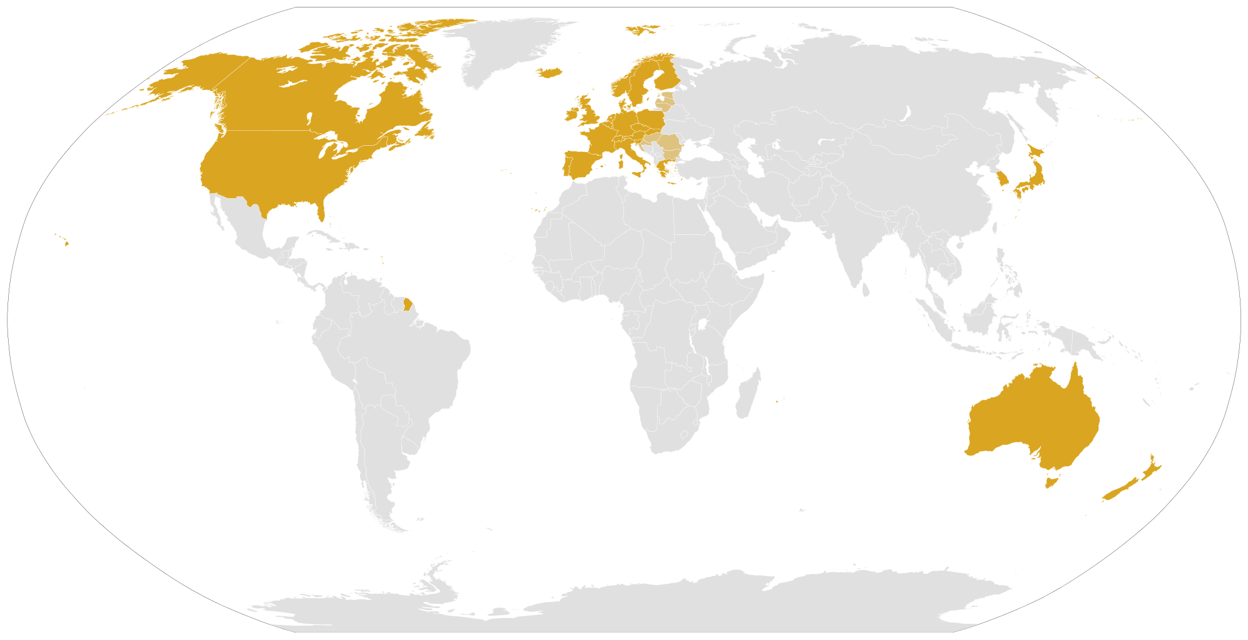
The performance of 37 development partners
Notes:
Increase of particpating DPs from 17 to 37!
93 % all DP signatories of IHP+ participated!
Also non IHP+ members, including 4 CSOs

Slide 13
Brief overview of Development Partners
Notes:
Variety of particpating DPs
Very different profile
Contributing to ODA: 6.8 Billion USD (USA) to 5 million USD (AfDB)
Proportion of ODA spent on health: 100% to < 5%
(no data for AsDB)

Slide 14
  Development partners continue to participate in processes for accountability at the country level (1)
Figure 12: Proportion of development funds disbursed through a mechanism aligned with the Country Results Frameworks
UP
Figure 13: Proportion of development partners in selected countries that are aligned with the Country Results Frameworks
UP
Notes:
Group of 3 indicators under Accountability:
The self-reported support and use of the CRF and the proportion of development funds disbursed through programmes that are monitored using the CRF.
The financial, technical and advocacy support provided to civil society organisations for participation in health policy processes.
The participation in mutual assessment(s) of progress in implementing health sector commitments, including on development effectiveness?
Figure 12:
Among the 15 development partners who provided data to the MOH in at least four countries, the proportion ranged from 98% by the World Bank to 34% by UNAIDS.
However some partners responsible for a large volume of health sector assistance were only 50% aligned.
Figure 13:
Serial data from countries and development partners that participated in performance monitoring over the last three rounds were only available for eleven countries.
They show an increasing alignment of development partners with national performance monitoring systems and procedures. An alignment of all partners was reported from all countries except Mozambique.
These results have to be interpreted with caution. They do not mean that the programmes of the participating development partners were fully aligned, but rather that all the partners had disbursed a proportion of their development funds through a programme that was aligned, such as a general or sector budget support programme and, in addition, that they participated in at least one of four possible processes to strengthen the country results framework.
(i) use of the CRF for own programme; (ii) programmes aligned with government programming cycles; (iii) participation in country-led health sector M&E; and (iv) adoption of the national M&E system

Slide 15
Development partners continue to participate in processes for accountability at the country level (2)
Figure 14: % of countries where development partners reported at least one type of CSO support
UP
Figure 15: Development partner participation in mutual health sector assessments in selected countries
LEVEL
Notes:
Figure 14
Development partners reported support for the participation of CSOs in health policy and planning in most countries.
In about three quarters of all partnerships, development partners provided at least one type of support to enable CSOs to participate in the health policy dialogue, a slight increase over previous rounds.
Of these 63% reported providing financial assistance to CSOs, 56% provided technical assistance and 37% supported CSO lobbying and advocacy roles.
Figure 15:
About a third of development partners reported that they participated in mutual health sector assessments in all countries that had established such processes.
Most development partners supporting more than three countries, participated in mutual assessments in 60-100% of those countries
While on the whole most DPs reported an increase in participation in mutual assessments between 2005/07-2011, from 2011-2014 there was a decline in participation in all except three countries.
Data on individual DPs shows that Germany, UK, UNAIDS, UNICEF and the EC reported using mutual assessments in all their countries. By contrast, the global funds (GFATM and GAVI) found it particularly challenging to participate in these processes. Amongst bilateral DPs, USAID, France and Spain reported the lowest levels of participation in mutual assessment

Slide 16
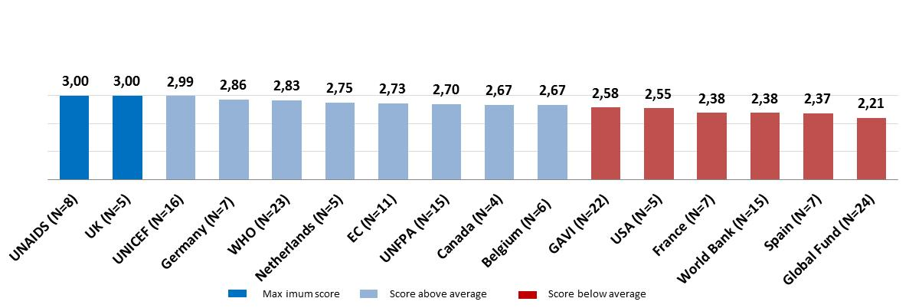
  Development partners continue to participate in processes for accountability at the country level (3)
Figure 16: Scores of development partners on 3 accountability indicators
Notes:
Overall conclusion on 3 accountability indicators
Overall, these findings suggest that while countries have worked hard to put accountability processes in place, there has been less progress among DPs in taking advantage of the processes to hold both each other and partner governments to account. For example, in Burkina Faso, Cape Verde, Nepal and Togo, governments reported a full complement of accountability processes but only 40-50 per cent of DPs reporting participating in them.
In the limited number of partnerships (countries with development partners) for which data from past monitoring rounds were available, the high level of participation noted in 2010/11 continued unchanged. Participation was, however, higher among those development partners who had submitted data in previous rounds than among those who joined for the first time. This is some indication of a positive trend towards greater participation in accountability processes.
Figure 16:
Drawing conclusions about the overall performance of development partner institutions is problematic because of the selected reporting of each partner in a limited number of countries. Added to this is the fact that the criteria for meeting the targets on the three accountability indicators were set low. Among the 16 development partners who submitted data in at least four countries, the average score was 2.67/3. Two partners achieved a full score of 3/3, while six scored below average

Slide 17
  Performance of development partners on financing and financial management is weaker, despite improvements in financing by partner countries (1)
Figure 17: Development partner health sector budget execution in 2013
DOWN
Figure 18: Combined government/development partner health sector budget execution in 2013
Notes:
4 financial indicators :
The level of execution of the health sector support budget in 2013
The proportion of support to the government sector that is registered in the national health sector budget
The predictability of funding communicated to government, in this case for the three years from 2015 to 2017
The proportion of financial support to the government sector that used national budget execution, financial reporting and/or auditing procedures
Figure 17:
In the 24 countries sampled, the 90% budget execution target for development partners was reached in 12 countries (13 countries for country performance)
Figure 18:
The combined target of 90% budget execution of both the government and the development partner budgets was reached in nine countries
When comparing results with the 2010/11 performance report for the 17 countries that participated in both rounds, the aggregate rate of development partner budget execution fell from 99% to 85%. However this is to a large extent due to the fact that there were major unscheduled disbursements in 2010, primarily by the Global Fund

Slide 18
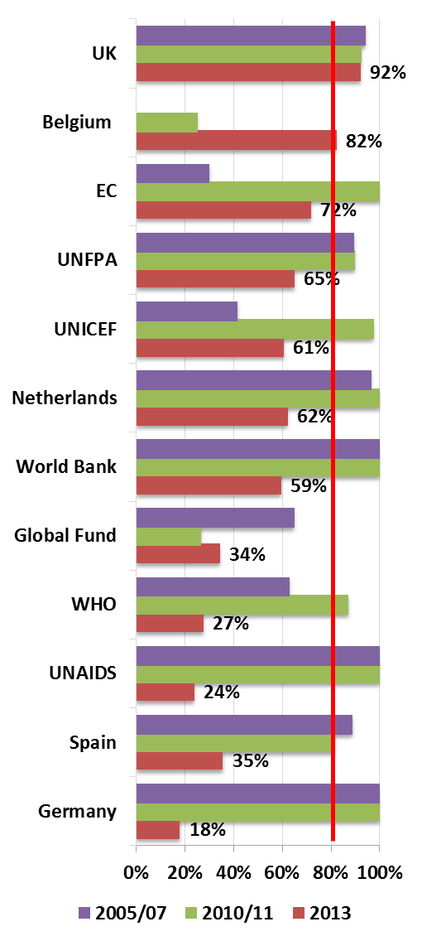
  Performance of development partners on financing and financial management is weaker, despite improvements in financing by partner countries (2)
Figure 19: Development partner forward expenditure estimates available to MOH
Figure 21: % of aid on budget by development partner
DOWN
LEVEL
Figure 20: % of total aid on budget
LEVEL
Notes:
Figure 19:
Spending estimates by development partners over the next three years. While the information for about 86% of the funds was available for the next year, it declined to 34% for year three
Figure 20:
The proportion of development funds recorded in the national budgets in 2013 was 71%, similar to the proportion reported in 2010/11 (72%). It had declined significantly from the level of 81% recorded in 2005/07. This finding, however, is sensitive to data provided by a few partners with large resource envelopes.
Difference between Figure 20 and Figure 21 is mainly due to the volume of funding reported on budget by each DP. Because GFATM has improved its performance and it’s volume is significant, the aggregate % of aid on budget has remained level.
Significant differences in the information provided by MOH and by DPs on the amount of development funds reported on budget. Data derived from both sources could therefore not be merged and the indicator was calculated using only self-reported data by developing partners
Among the development partners for whom serial data from past monitoring rounds were available, only the UK reached the target of 85% of support to the government sector reported in the national budget. Almost all reported significant reductions except Belgium and the Global Fund.

Slide 19
Performance of development partners on financing and financial management is weaker, despite improvements in financing by partner countries (3)
Figure 22: % of partner funds using national PFM system
DOWN
Figure 23: % of partners using PFM process in countries with CPIA≥3.5 (N = # partners/country)
DOWN
Notes:
Figure 22:
While there was slight improvement in the financial management systems of partner countries, they were only used to manage 43% of development partner funds in the 12 countries with CPIA scores > 3.5. Of these, for eight countries with serial data , the use of national public financial systems by development partners dropped to a low 41% in 2013, from 65% in 2010/11 and 42% in 2005/07
Figure 23:
Large variation of use of PFM system between countries
Aggregate performance data mask substantial variation among DPs. Some development partners, for example the Netherlands and Spain, consistently used at least two of the three national financial management processes. Many others, including some of the largest contributors such as the Global Fund and the US Government, used national systems for less than 20% of their contributions.

Slide 20
The performance of developing partners on financial management of assistance has stagnated despite improvements of financial management in partner countries (4)
Figure 24: Scores of development partners on 4 financial cooperation indicators
Notes:
Overall, DP performance in meeting the commitments on financial cooperation has been at best static and less convincing than the performance on the commitments to accountability processes.
- Out of a total possible score of four, only Canada came close to the target of 3.43.
The average score of the 16 partners who participated in at least four countries was 2.1,
7 development partners scored below the average, eg. Spain and USAID (most recent members) but also WHO, Germany, France and GAVI (original signatories of the Global Compact).

Slide 21
  The overall performance of development partners on meeting their commitments to effective cooperation is lower than that of partner countries, but at the country level the scores obtained by both partners are correlated
Figure 25: Overall score of development partners on 7 indicators
Figure 26: Correlation between the scores of partners at country level
Notes:
Figure 25
The 16 development partners that reported on at least four countries achieved an average of score 4.8 out of a total possible of seven.
This was lower than the mean score of 5.1 achieved by the partner countries, even though for some indicators development partners faced considerably lower barriers to achieving the targets than countries (for instance, for the engagement of civil society and for participation in processes for mutual accountability).
None of the development partners reached the target of 6.34; Canada came closest albeit with data reported for only four countries.
There are many reasons why development partners may fail to reach targets on meeting commitments for development cooperation. They may operate primarily in countries where it is more difficult to meet commitments, or where the conditions for improved mutual accountability and enhanced financial effectiveness do not exist. They may have governance bodies that do not prioritise or incentivise development effectiveness. There was no pattern according to whether the partners were bilateral or multilateral agencies: UNICEF performed well, UNFPA less so; Canada and the UK outperformed Spain and France.
BUT: At the country level the scores obtained by partner countries and development partners are correlated. So it is plausible that DPs are more likely to perform better in countries with a conducive policy environment. Likewise, countries working with effective development partners have more incentives to improve their policies and systems. As in any partnership, it is likely the interaction between both that is responsible for the outcome.

Slide 22
6 Take home messages
There is some correlation between the length of stay in the partnership and overall score on development effectiveness for countries
Performance by governments and development partners are correlated
Countries have generally made progress in meeting commitments, particularly in the area of developing tools for accountability and engaging CSOs, although there is wide variation in country performance and CSOs have a different view

Slide 23
6 Take home messages
Many countries have increased their domestic funding for health and developed medium term forecasts, but there has been limited progress on improving financial management systems.
Compared with 2012, some DPs score worse particularly on the financing indicators; again there is variation in performance
Need to use the findings from this monitoring especially at country level, as a tool for accountability - some experience already this year.

Slide 24
“As in any partnership, it is likely the interaction between both partners that is responsible for the outcome”
Thank you for your kind attention
Leo Devillé

