Slide 1
Pharmaceuticals Procurement
and Supply Management:
The case of Ethiopia
Cambodia, December 4, 2014

Slide 2
Presentation outline
Background
Updates on National procurement & Supply management
Priority Areas
Ways forward

Slide 3
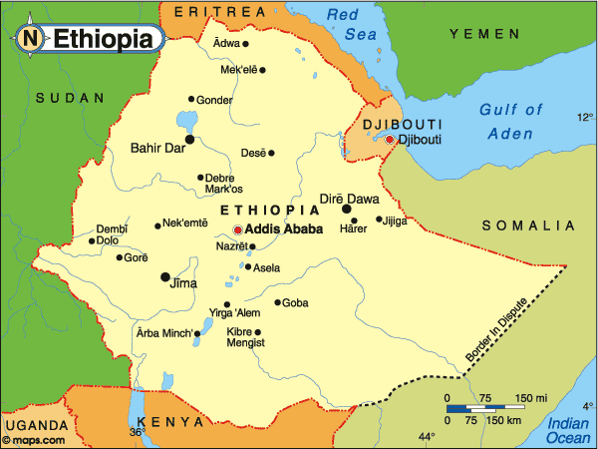
Country Background
Ethiopia is located in the Eastern part of Africa
Area: 1,104,300 square kilometers
Total Population: 90 million (CSA projection for 2014)
Average size of household: 4.6
Ethiopia is Decentralized country:
9 Administrative regional states
2 City Administrations
Annual Pharmaceutical procurement by Public Supply chain → PFSA reached ≈ 10 Billion Birr (500 Million USD )

Slide 4
…Background
Efforts to strengthen the Supply chain management of Ethiopia begin with development of Pharmaceuticals Logistics Master Plan (PLMP) in 2006.
PFSA was established by proclamation in September 2007 and mandated to “avail affordable and quality assured pharmaceuticals sustainably to all public health facilities and ensure their rational use”.
As per the reform finalized in 2009, the Pharmaceutical Supply and Service is considered as one of the eight core processes of Federal Ministry of Health of Ethiopia
Since its inception the Agency has followed the Integrated Pharmaceutical Supply approach starting with rational selection, consumption based forecasting and pooled procurement and need-based distribution

Slide 5
In the past years so many capacity building training and support were given to health facilities to enhance their inventory management and quantification efficiency
For medicines procured by Revolving Drug Fund (RDF), the health facilities are placing their orders to the near by PFSA branch offices which were in turn aggregated at national level for pooled procurement.
For program items ( ARVs, TB medicines, Anti-malarial and Family planning commodities), the quantification is done at National Level with the involvement of all stakeholders (FMOH, PFSA, RHB, health facilities and all development partners supporting respective programs)

Slide 6
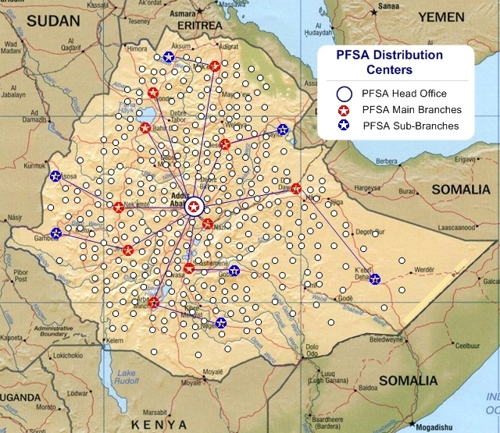
Note: Beyond having a well organized central office the agency has regional presence through its currently functional eleven branches and has been working towards having more branch offices
i.e. construction of warehouses in order to realize access to all public health facilities within 160 - 300 km radius.
There should be PFSA HUB within 160-300 Km radius

Slide 7
Pharmaceuticals Procurement

Slide 8
procurement Directorate of PFSA selects appropriate procurement method, develop tender document and announce the tender.
In most cases ICB and Restricted tenders
We do procurement through different sources including GF, PBS/WB, MDG, Government fund and other development partners fund
PFSA is also procuring sophisticated medical
equipments like MRI, CT scan, Mammography
Machine …

Slide 9
Bringing different procurement processes to one
In Ethiopia development partners are preferring the government procurement process due to
Establishment of the Pharmaceutical Fund Agency(PFSA)
Strengthened transparency, accountability and quality control of PFSA
Web site, Audit, FMHACA, IPLS , APTS
Candid dialogue between MOH and Partners
JFA, Governance structure

Slide 10
Warehouse at Center and regions
Warehouse at Bahir dar Branch
17 Modern warehouses are under construction → this will increase the storage capacity from 46,000M³ to 580,000 M³. Will increase
Access to medicines

Slide 11
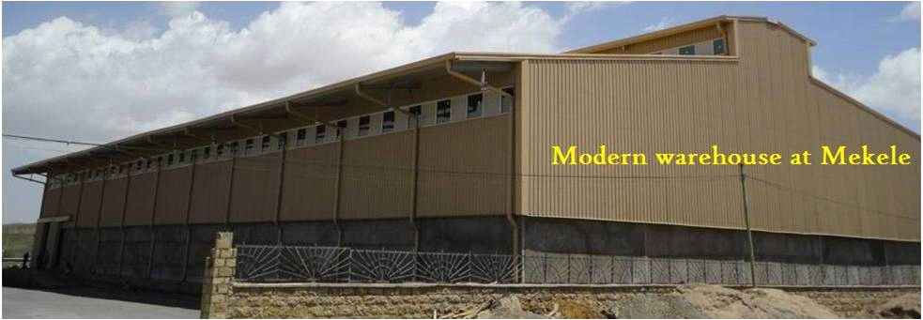
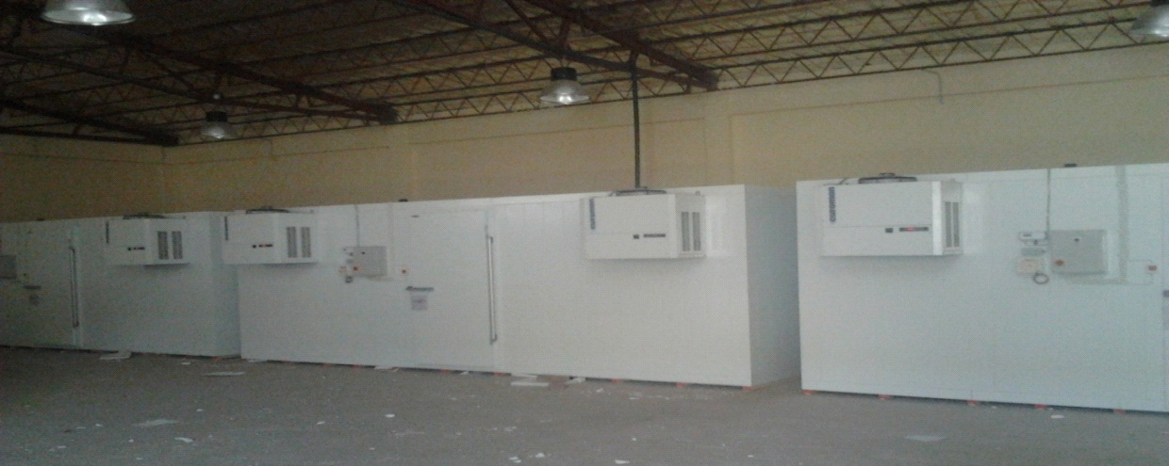
17 cold warehouses of
8000 M³ capacity
Cold warehouses are also constructed in all of the 17 hubs

Slide 12
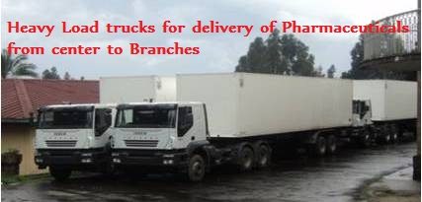
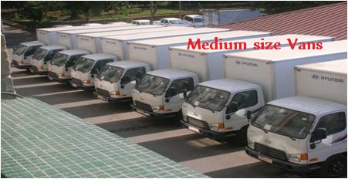
Distribution
More than 160 vehicles with different capacity were procured and deployed
21 vehicles in 2000 E.C 171 at the end of 2006 E.C
Note: The Ministry is working to further strengthen the storage and distribution capacity of the Agency

Slide 13
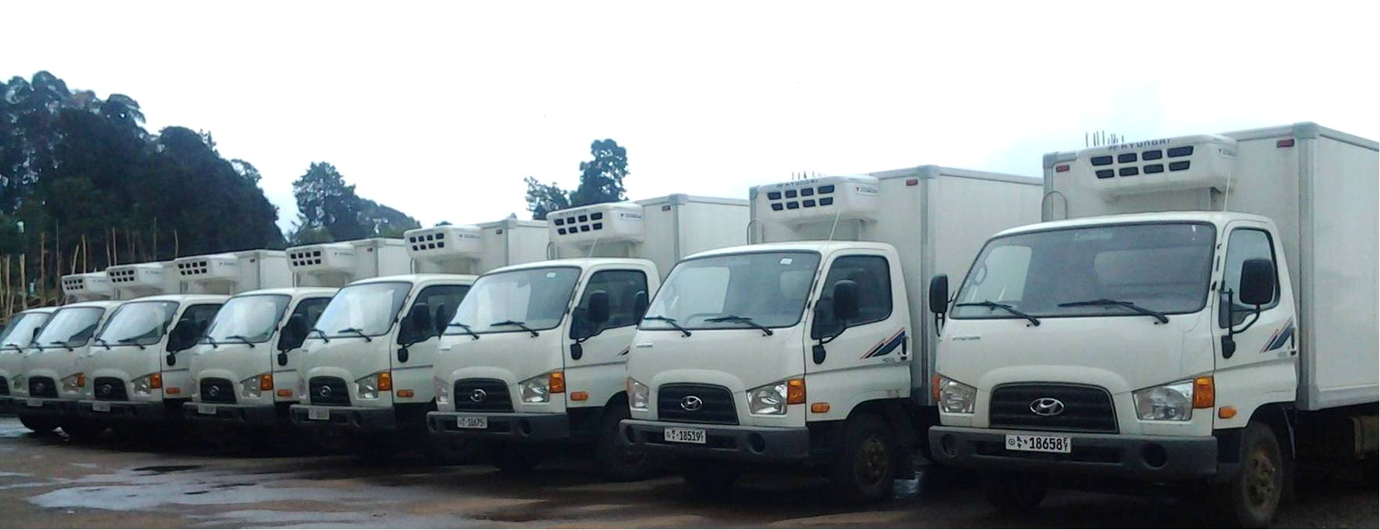
17 Refrigerated trucks were procured and deployed to strengthen EPI logistics and pharmaceuticals requiring cold chain.
Annual distribution capacity reached 10.5 Billion Birr by the End of 2006 EBY (2013/2014G.C),
Plan for 2007 EBY is 12.2 Billion Birr (≈ 600 Million USD) → more than 17% fold when compared to 2000 BY

Slide 14
Challenges
Poor demand forecasting and inventory management and logistics data from end users and other levels of the supply chain.
Information linkage
Delay in procurement process (some times)
Limited suppler pool for some products
Limited local capacity to manufacture essential medicines → dependency in global market.
Price fluctuation in international market

Slide 15
Way Forward
We will strengthen quantification and inventory management at all levels & procurement efficiency at national level
We need to strengthen Logistics Management Information System: towards having one and efficient system of information management
We will build strategic partnership with potential suppliers and strengthen local pharmaceutical manufacturing capacity

Slide 16
Thank You

