Slide 1
Supporting Southern CSO engagement in policy dialogue and performance monitoring:
What should be the future role of IHP+ ?

Slide 2
Health Policy Action Fund
Established 2009
Managed by OXFAM (Germany)
Number of grantees: 23 in 13 countries
Individual grants around 30,000USD
Disbursement around 1 mill USD
Funding ending now

Slide 3
Findings of HPAF Review
Achievements:
Played a unique and positive role in facilitating CSO engagement in national health policy dialogue and accountability processes
Very few alternative sources for this broad type of support

Slide 4
Findings of HPAF Review
contnd.
Areas for improvement:
More emphasis on capacity building
Longer grant time-frame
Few grantees understood aid effectiveness well

Slide 5
Future CSO support options
Review recommend continuing support
Of the four models proposed two are favored by stakeholders (C and D):
Model C: A variation of the HPAF model with more focus on national CSO coalitions and on capacity building
Model D: Scaling up the approach: more countries and grantees and longer grant period. Possibly de-linked from IHP+

Slide 6
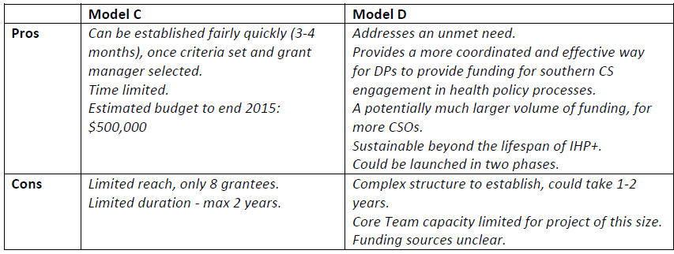
Main pros et cons

Slide 7
Questions for SC
Should IHP+ CSO support continue?
If yes, which model is preferred:
Model C: Continue adapted HPAF model
Model D: Scaling up the approach
Some combination

