Slide 1
Health system strengthening
for
Universal Health Coverage
and
Health systems resilience

Slide 2
Overview & main messages
SDG
  Health is well placed. UHC is the underpinning target and is essential to the achievement of all health targets
Health systems strengthening (HSS), UHC, health system resilience
  HSS is the means to achieve the goals of UHC and resilience
  The improved definition of UHC is explicit about including protection from health threats
Guiding principles for UHC
  It is possible to identify a set of core principles, in line with the SDG, that all stakeholders should adhere to
Addressing the HSS gap
  New ways are needed to address the gap in HSS, leveraging domestic funding and changing the focus of development assistance for health

Slide 3
Health and the Sustainable Development Goals
Health & UHC are in a central place
Health is one of 17 goals and also prominent with in many other goals
  "Ensure healthy lives and promote well-being for all at all ages"
  The SDG are: "Integrated and indivisible": progress in one area is dependent on progress in many others
  Health contributes to the achievements of many other goals and targets and vice versa
SDG text on the new agenda (point 26 of declaration):
“To promote physical and mental health and well-being and to extend life expectancy for all, we must achieve universal health coverage and access to quality health care. No one must be left behind. We commit to…” .(thereafter follows a brief summary of health targets).
This places UHC as the target that underpins and is key to achievement to all the other health targets.

Slide 4
What are the links between UHC and health system resilience?
Both are goals of health systems strengthening
Both require capacities for good governance, financing, health workforce, data, medical products, health infrastructure / service delivery

Slide 5
Towards an improved definition of UHC
UHC redefined?
All people and communities receive the quality services they need, and are protected from health threats, without financial hardship

Slide 6
Key considerations in addressing the HSS gap for UHC and resilience

Slide 7
What is the “HSS gap”?*
$55 billion: minimum estimate of additional annual resources needed globally for low- and lower-middle income countries to attain the SDG health targets by 2030
$35-$40 billion: is the amount needed for health systems strengthening investments, as part of the $55 bln
$2.3 billion: current annual external funding for HSS in these countries
Funding for health systems, even in most low income countries and fragile states, comes predominantly from domestic sources
*Based on our work as part of the Lancet Commission Global Health 2035, and
analyses prepared for the 3rd Financing for Development Conference

Slide 8
What the numbers tell us
Main sources of external funding are bilaterals, GFATM and GAVI
  WHO provides less than 1% of external funding for health
Even in aid-dependent low income and fragile states, domestic resources are typically 75% of total health spending
Most external funding is for specific diseases; very little (under 10%) is for health systems
External funding is important but working at the margins.
The “big game” is domestic financing for domestic health systems. Currently international support does not effectively leverage this, but instead promotes disease-specific accountability. Change needed if we are serious.

Slide 9
Need to re-orient international support to focus on domestic health systems
Not really a question of simply investing to fill an “HSS gap” (though may be relevant in some countries with absolute shortfalls of health workers and other key inputs)
Mainly an issue of strategically supporting domestic financing and overall health policy processes to leverage better results from “the 75%” (i.e. domestic resources)
  Requires in-country capacity for policy support
  Aligning accountability with overall national goals (security, UHC, resilience) and not narrowly for a multitude of silos
  Enforcing IHP core principles for domestic health systems
  WHO well-positioned to support governments on this agenda

Slide 10
Emerging messages
The financial gap is large but not huge; filling it will be primarily a job for domestic financing
  Increasing domestic government health spending from 2% to 3% of GDP would address most of the gap
  The Addis Ababa Action Agenda messages on strengthening tax systems and reducing illicit financial flows are absolutely critical
Most of the gap is health systems, but the existing international architecture is not addressing this yet
  Need to channel resources in a way that provides better leverage to influence the level and use of domestic resources, and to align accountability with national priorities rather than those of external funders

Slide 11
HSS is key for progress on shared goals of
UHC, health security and resilience
SDGs are about country systems
HSS needs are formidable
Domestic financing can be mobilized
Not about piling bricks, but about the cement
Cement will be different in different contexts: Fragile States, Transition and MIC
Shift in focus of aid is needed

Slide 12
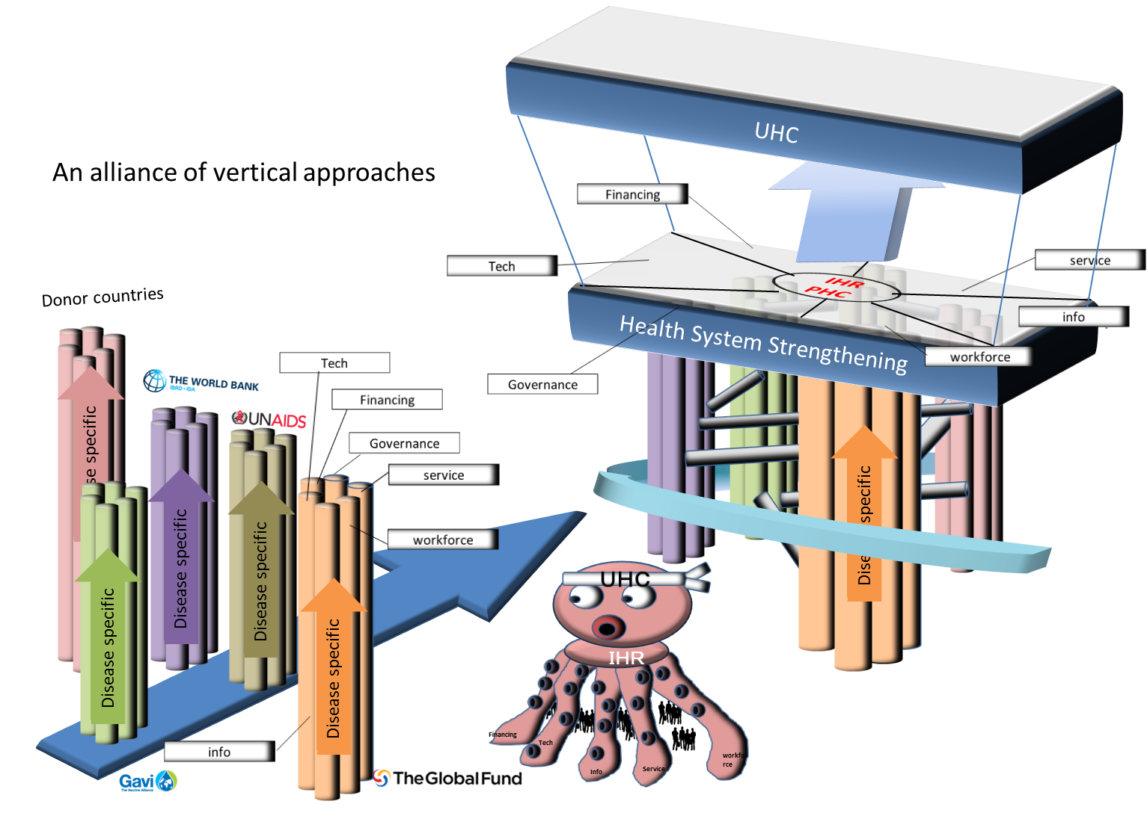
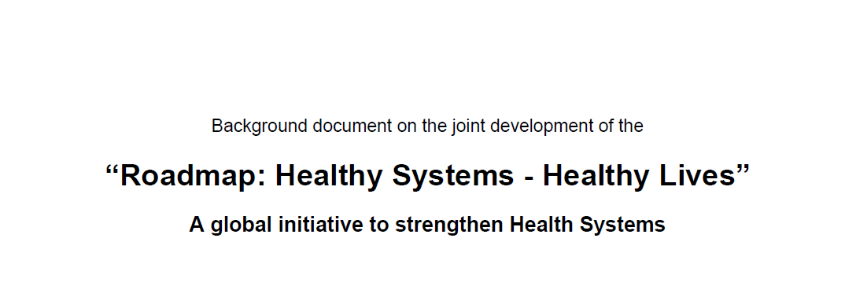
Two major G7 Initiatives
Japan
Germany
political opportunity to include systems thinking into UHC

Slide 13
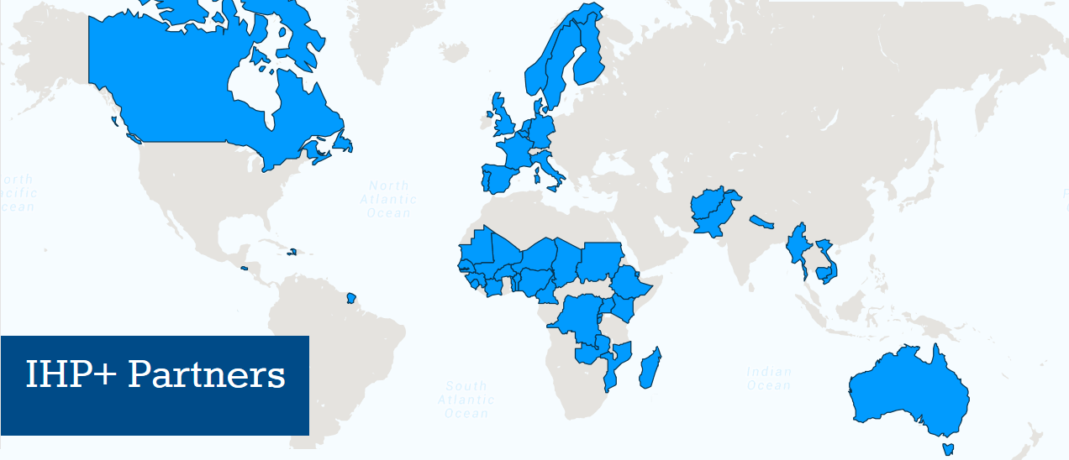













Using the network of IHP+ partners as a platform?
+ civil society

