Slide 1
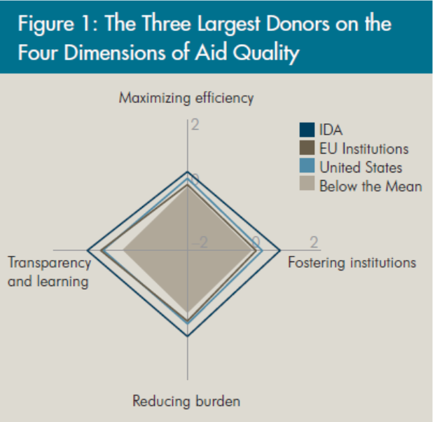
What is "QuODA"?
A methodology to measure donors' performance, developed by the Brookings Institution and the Center for Global Development
Expressed through a single index across four dimensions of aid quality, adapted from the Paris principles
For each dimension, 7-8 indicators, each getting a score, weighted to get the final score for the dimension
Uses readily available data from the OECD’s Creditor Reporting System (CRS) database and the Survey on Monitoring the Paris Declaration.
Purpose: assessment of the quality of official development assistance; (an adaption for health aid also developed)
Coverage: data for 23 donor countries and more than 100 aid agencies
Paris Declaration principle | QuODA dimension
Results | Maximizing efficiency
Ownership | Fostering institutions
Alignment | Reducing burden
Mutual accountability | Transparency and learning

Slide 2
Methodology issues
Main drive: to include elements of aid quality, such as for example perceptions of recipient countries
Indicators are cardinal, not ranking – assess progress over time
Definition of aid: Country Programmable Aid (CPA)from OECD/DAC: total amount of aid that can be programmed by the donor at the recipient country level, with some specific exceptions
Source of data:
OECD Creditor Reporting System (CRS)
AidData
OECD Survey on monitoring the Paris Declaration (2008)
World Bank Aid Effectiveness Review (2007)
DAC Report on Aid Predictability (2009)
Gallup organization 2008 World Bank group Global Poll
World Values Survey (www.worldvaluessurvey.org)
Latino, Euro, Asian and Afro barometer surveys
Index of governance vulnerability
UN National Accounts main aggregate database
IMF World Economic Outlook
OECD’s Creditor Reporting System (CRS)
The authoritative source of annual activity-level statistical information on Official Development Assistance (ODA), other official flows (OOF), and some private aid flows from the 24 OECD DAC members. It is maintained by OECD/DAC and contains information on the aid activities of many major multilateral organizations and several other non-DAC donors that is collected directly from these organizations.
AidData
is a collaborative initiative to provide products and services that promote the dissemination, analysis, and understanding of development finance information. At the core of the AidData program is the AidData web portal, which is a gateway to nearly one million past and present records of development finance activities from donors around the world. Complementing the work of the OECD, it is not an official source of data for any one or group of donors;

Slide 3
Four dimensions and 30 indicators of QuODA
Maximizing efficiency | Fostering institutions | Reducing burden | Transparency and learning
Share of allocation to poor countries a | Share of aid to recipients’ top development priorities a,b | Significance of aid relationships a | Member of International Aid Transparency Initiative a
Share of allocation to well-governed countries c | Avoidance of project implementation units b,c | Fragmentation across agencies c | Recording of project title and descriptions
Low administrative unit costs a | Share of aid recorded in recipient budgets b,c | Median project size a b | Detail of project descriptions
High country programmable aid share a | Share of aid to partners with good operational strategies a | Contribution to multilaterals a | Reporting of aid delivery channel
Focus/specialization by recipient country a,c | Use of recipient country systems b,c | Coordinated missions b,c | Share of projects reporting disbursements
Focus/specialization by sector a,c | Coordination of technical cooperation b,c | Coordinated analytical work b,c | Completeness of project-level commitment data b
Support of select global public good facilities a | Share of scheduled aid recorded as received by recipients b,c | Use of programmatic aid b,c | Aid to partners with good monitoring and evaluation frameworks a
Share of untied aid b,c | Coverage of forward spending plans/Aid predictability a,b
Note: The 30 indicators are flagged by the type of source that advocates for their use as a benchmark:
a. Academic literature. b. Recipient governments. c. Paris Declaration.

Slide 4
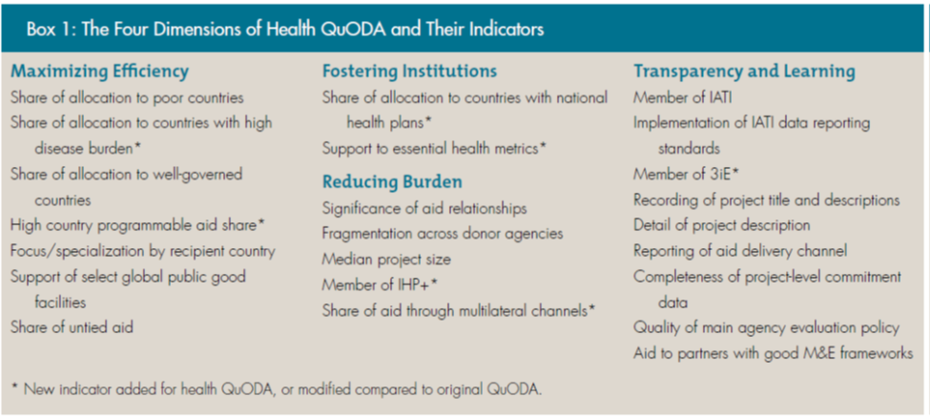
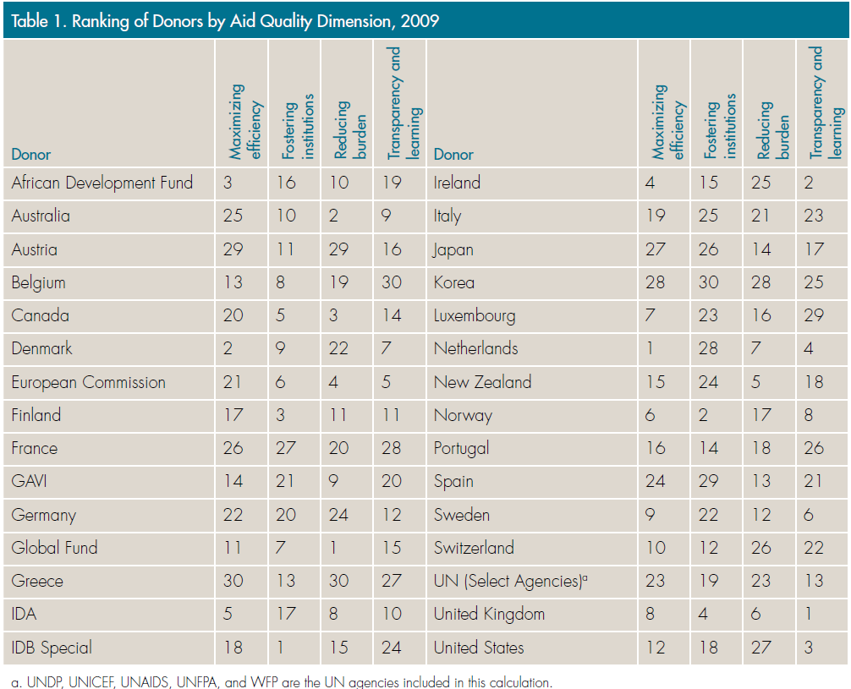
Source: Glassman A, Duran D. Quantifying the Quality of Health Aid: Health QuODA. CGD Brief, May 2012

