Slide 1


What has changed in
5 years ?
3 cycles of independent monitoring of the IHP+
Geneva, 4th October 2012
Strengthening Accountability to Achieve the Health MDGs

Slide 2
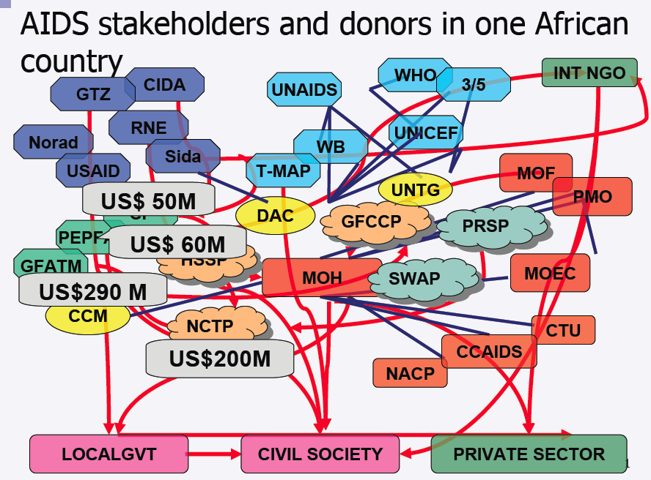
Starting in 2007…

Slide 3

IHP+ Global Compact
  Agreement to put the Paris Framework into practice in the health sector, for Health Systems Strengthening

Slide 4
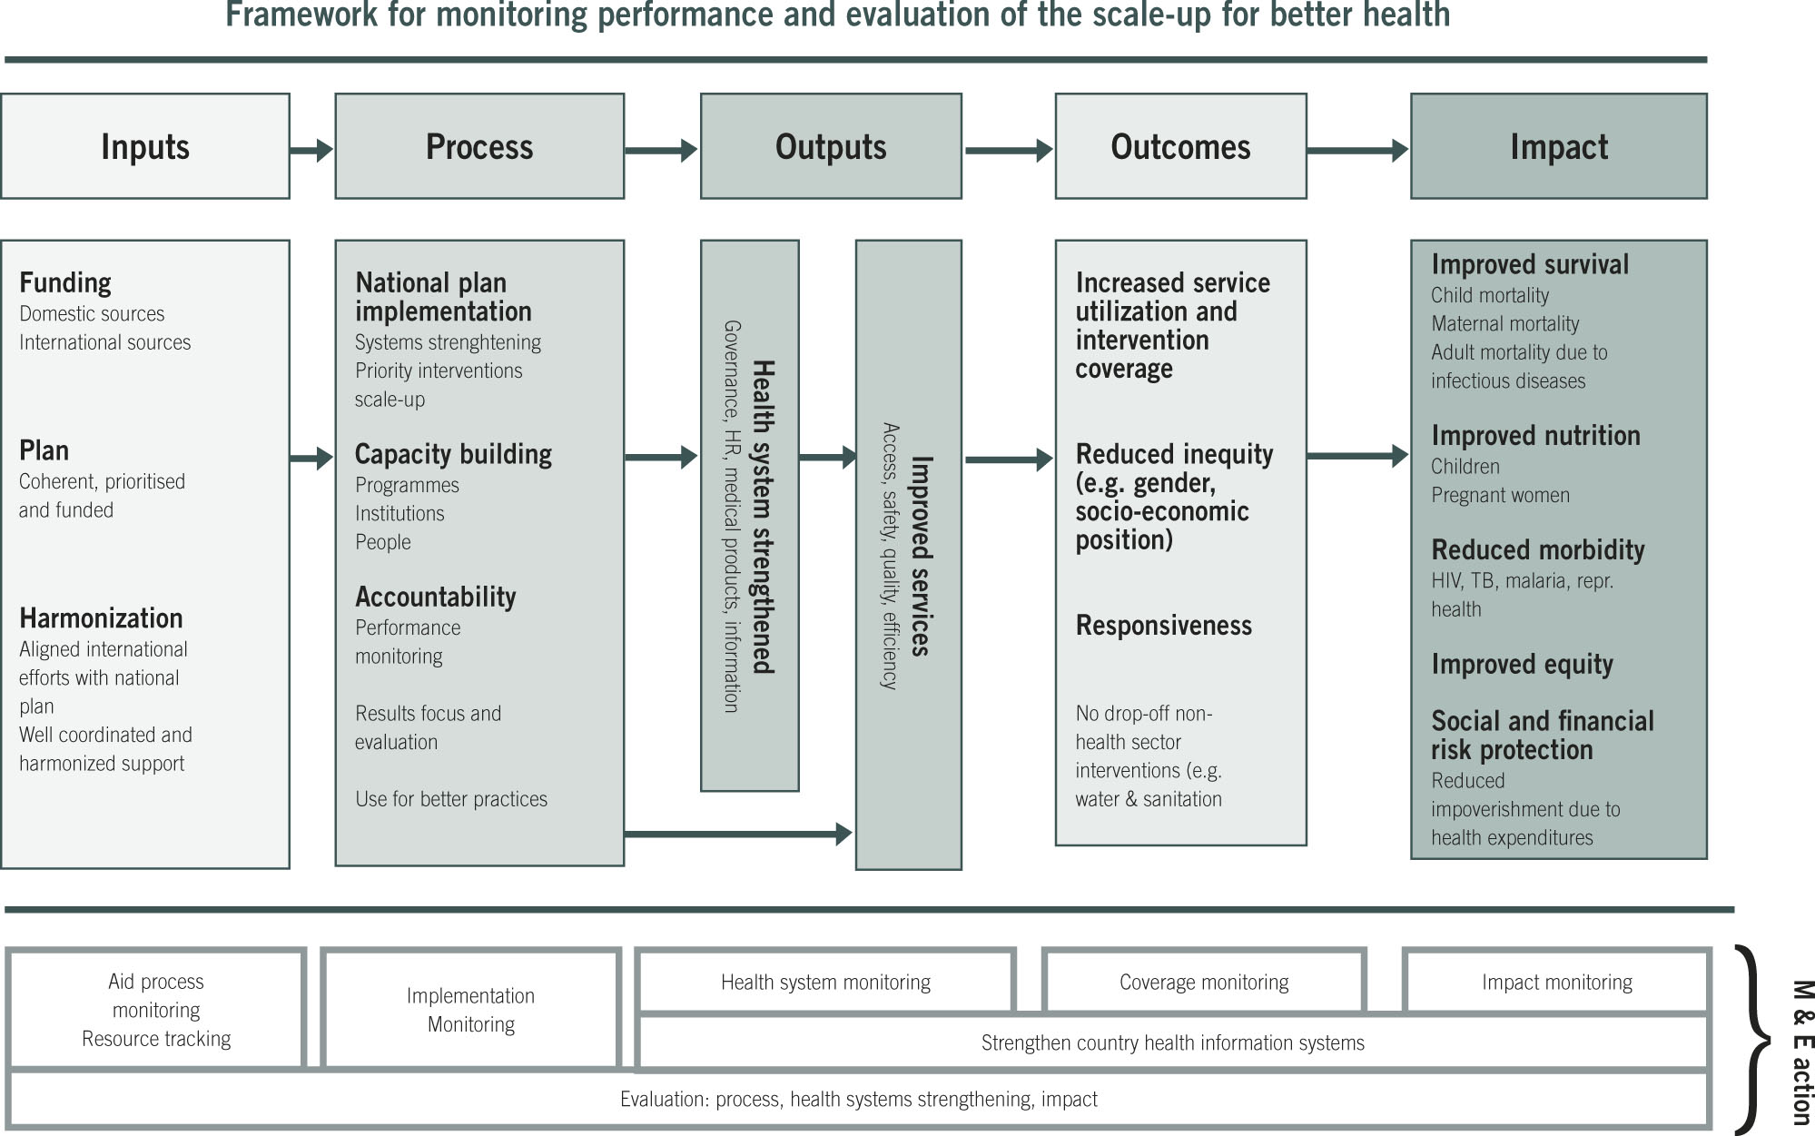
What was expected to change?

Slide 5
IHP+Results
2. Transparent Information from Performance Reporting & Monitoring
3. Mutual Accountability Processes with Forum for Discussion
AVAILABILITY
COLLABORATION
COORDINATION
HEALTH RESULTS
THROUGH STRONGER HEALTH SYSTEMS
COLLECTION
UTILISATION
1. Mechanism for Participation, based on IHP+ Global and Country Compacts
DEMAND
COOPERATION
Notes:
An so the question is – “how can we use these results?”

Slide 6

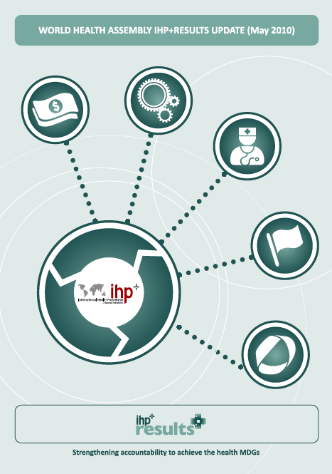
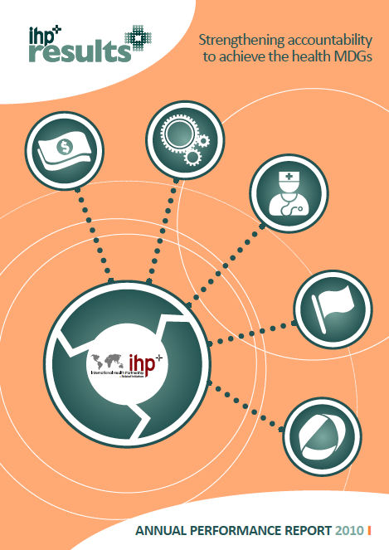
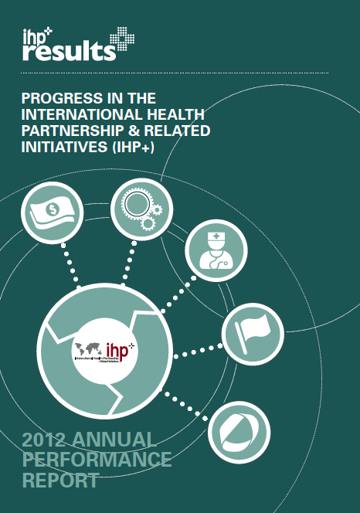
Monitoring over 5 Years
August 2008
May 2010
April 2011
October 2012
Significant meetings:
Ministerial Review 2008
Country Health Sector Team meetings (Bamako June 2009; Brussels Dec 2010)
World Health Assembly side events: 2010, 2011, 2012.

Slide 7
15 Development Partners
10 Countries
4,000+ Data Points!
10+12 Standard Performance Measures
Baseline Data
2009 Data

Slide 8
17 Development Partners
19 Countries
6,000+ Data Points!
10+12 Standard Performance Measures
Baseline Data
2009 Data
2011 Data

Slide 9
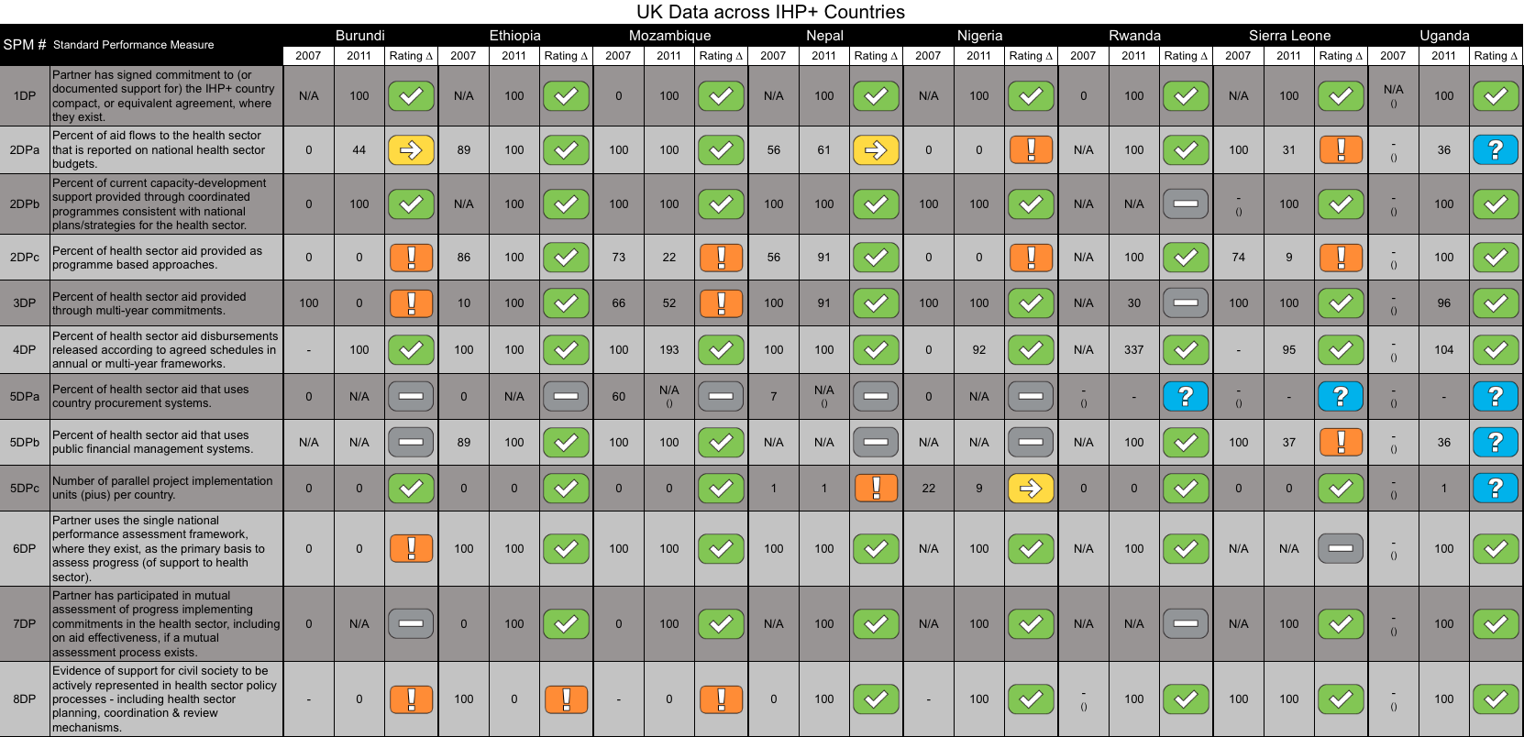
Transparent (and credible) picture of performance over time

Slide 10
What is changing?
Have a more informed picture of what is happening
Better cooperation & coordination in most countries
Some collaboration between partners to manage for results & to put in place mutual accountability
BUT
No significant (‘step-change’) improvements in the quality of Health aid delivered to IHP+ Partner Countries

Slide 11
By 2011, Development Partners met only 3 of 12 targets (unchanged since 2009)
Least DP progress on measures of actual aid delivery:
multi-year aid commitments, aid that is recorded on country budgets, and aid that uses country systems.
Partner Countries made less than expected progress on improving health budget allocations and disbursements

Slide 12

Country Public Financial Management Systems
PARTICIPANTS IN 2010 & 2012
PARTICIPANTS ONLY IN 2012
0.5
0.5
0.5
0.5
1.0
1.0
1.0
0.5
0.5
0.5
0.5
Notes:
LEFT HAND COG: TITLE – PARTICIPANTS IN 2010 AND 2012 IHP+RESULTS MONITORING
KEEP COUNTRY NAMES THE SAME.
FILL LEVELS AS FOLLOWS (5 IS COMPLETELY FULL – BURKINA FASO IS CURRENTLY SHOWING 4.5)
COUNTRY NAME FILL LEVEL (CHANGE SINCE BASELINE)
BURKINA FASO 4.5 (+0.5)
BURUNDI 3.0 (+0.5)
DRC 2.5 (NO CHANGE)
DJIBOUTI 3.0 (NO CHANGE)
ETHIOPIA 3.5 (NO CHANGE)
MALI 3.5 (-0.5)
MOZAMBIQUE 4.0 (+0.5)
NEPAL 2.5 (-1.0)
NIGER 3.5 (NO CHANGE)
NIGERIA 3.0 (NO CHANGE)
RIGHT HAND COG: TITLE – PARTICIPANTS IN ONLY 2012 IHP+RESULTS MONITORING
COUNTRIES AS LISTED BELOW. 1 SECTION WILL BE GREYED OUT – UNLESS IT’S EASY TO DIVIDE THE COG BY 9 INSTEAD OF 10?
FILL LEVEL SCALE IS THE SAME AS ABOVE. WE’LL NEED TO INCLUDE ‘NO DATA’ IN THE KEY AND PERHAPS COLOUR IT BLUE – SAME AS THE ? RATING SYMBOL?
COUNTRY NAME FILL LEVEL (CHANGE SINCE BASELINE)
BENIN 3.5 (-0.5)
EL SALVADOR NO DATA
MAURITANIA 3.0 (+1.0)
RWANDA 4.0 (+0.5)
SENEGAL 3.5 (NO CHANGE)
SIERRA LEONE 3.5 (NO CHANGE)
SUDAN 2.0 (-0.5)
TOGO 3.0 (+1.0)
UGANDA 3.5 (-0.5)
PLEASE DELETE THE SMALLER COG IN BOTH LEFT AND RIGHT HAND VERSIONS.

Slide 13
Aid flowing through country PFMs
[For 10 Countries with data for all 3 rounds]

Slide 14

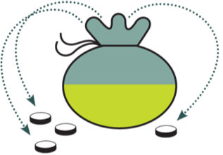

Donors putting their money
‘on budget’ for health
52%
52%
79%
61%
2007
2009
2011
2007 2009 2011
^{2DPa:} Aggregate proportion of partner support reported on national budgets

Slide 15
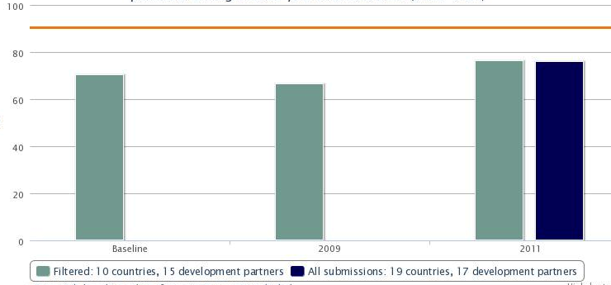
Predictability of funding
3DP: health sector aid provided through multi-year commitments

Slide 16

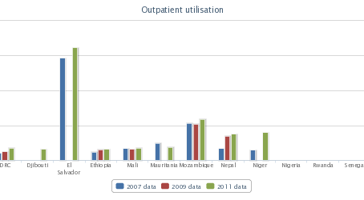
Changes in Health Systems

Slide 17

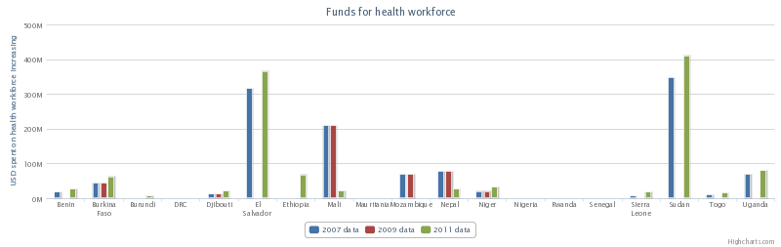
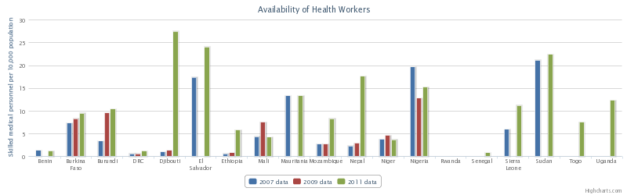
Health Workforce

Slide 18
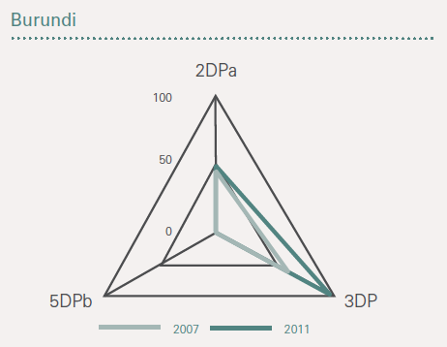
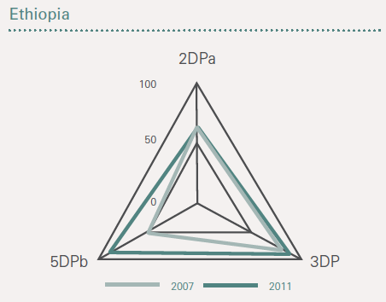
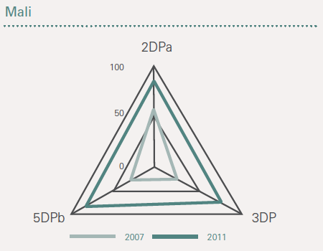
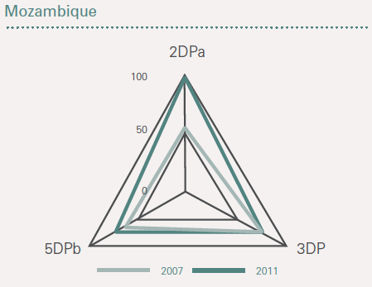
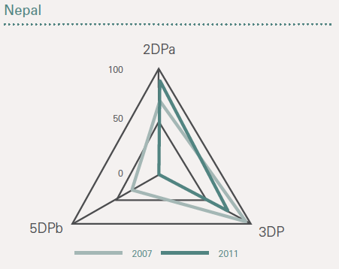
Progress in ‘first 5’ countries
All had the 4 pillars in place (Compact + National Health Plan + Performance Assessment Frameworks + Mutual Accountability Process)
  All received more external aid recorded on their national budgets from 2009 to 2011 (Target met in Nepal, Mali and Mozambique)
A mixed picture on the extent of multi-year commitments by donors…
…but trend towards increased levels of predictability in 4 countries (2 even had significantly more aid delivered than planned for).
Notes:
5 countries (Burundi, Nepal, Ethiopia, Mali, Mozambique) joined the IHP+ as signatories to the Global Compact in 2007 and have had the longest period over which to demonstrate changes in how their Development Partners deliver aid to the health sector.

Slide 19
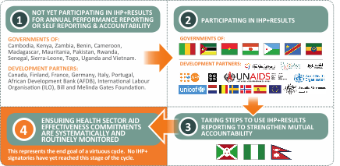























Where to from here?
The value of Performance Monitoring for Accountability
1
NOT YET PARTICIPATING IN IHP+RESULTS FOR ANNUAL PERFORMANCE REPORTING OR SELF REPORTING & ACCOUNTABILITY
2
PARTICIPATING IN IHP+RESULTS
GOVERNMENTS OF:
Cambodia, Cameroon, Cape Verde, Chad, Côte d’Ivoire, Gambia, Guinea, Kenya, Madagascar, Pakistan, Vietnam, Zambia.
DEVELOPMENT PARTNERS:
Canada, Finland, France, Italy, Portugal, International
Labour Organisation (ILO), Bill & Melinda Gates Foundation .
GOVERNMENTS OF:
DEVELOPMENT PARTNERS:
4
ENSURING HEALTH SECTOR AID EFFECTIVENESS COMMITMENTS ARE SYSTEMATICALLY AND ROUTINELY MONITORED
3
TAKING STEPS TO USE IHP+RESULTS REPORTING TO STRENGTHEN MUTUAL ACCOUNTABILITY
The end goal of a virtuous cycle.
Notes:
Principles: clear mandate, agreed methodology, voluntary, limited transaction costs, using existing data, building on existing processes
Monitoring must take place at country-level – promote ownership, enable participation of civil society; Global processes need to be adaptable by countries
Need to use findings to stimulate discussion at global and country level
Must continue to learn, adapt and improve IHP+ processes and tools
Continued focus at country level is key
Strategic focus on key issues can support country progress
Focus on quality of policy/planning framework/pillars
Focus on areas of underperformance
Country systems
Mutual accountability, civil society capacity to participate in policy and accountability mechanisms

Slide 20
Recommendations
Do what’s necessary to actually deliver more effective health aid!
Make better use of Mutual Accountability mechanisms to drive this progress
Ensure future reporting & monitoring is fully owned by stakeholders
Continue monitoring & provide more real-time information that decision-makers need to know

Slide 21
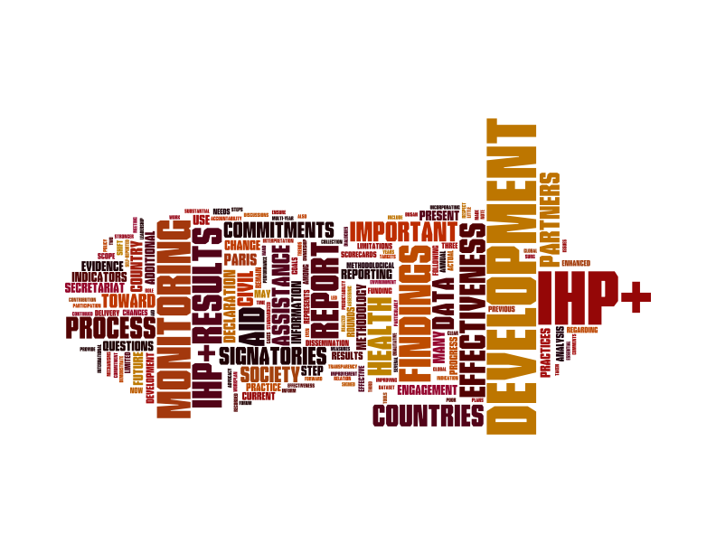

Slide 22
?
  Is this information relevant, interesting and useful to improve investments into the health sector?
  How can we make better use of this information?

