Slide 1
The SRSS and the Paris Declaration in the DR of Congo
Hyppolite Kalambay
Direction d’Etudes et Planification
Reforme du secteur de la santé

Slide 2
Outline of the presentation
Elements of he national context
2005: a strategy for establishing the MSP leadership on the sector
Costing and sector planning
Reform of health financing -some results
Conclusion

Slide 3
Recent national context
Reduction of health financing
RHS
Governance

Slide 4
2005: establishing the leadership
The SRSS:
A strategy of sector reform based on the revitalisation of DS (PHC)
A strategy of reform of governance
A strategy of reform of financing: a better coordination of donors for “defragmenting” the health system
Link with the administrative decentralisation
Challenge: to overcome the resistances in an international context ruled by the selective approach to diseases
IPH+ and the 2008 report : big opportunities for the DRC

Slide 5
Costing and planning
The cost for launching the development of the Health District is known;
The process for the Health Zones is on-going (ownership)
They offer the framework for the alignment and harmonisation of partners;
But…

Slide 6
Reform of health financing – some results
The reform benefits from the support, both technical and financial, of all partners even if its utilisation is gradual

Slide 7
Implementation of a model based on the development of DS

Slide 8
Some results (Health Zones of Lubunga and Kisantu
Service utilisation in the health centres
Referral rate to the general hospital

Slide 9
Trend of maternal mortality 1990-2008 in relation to the 2015 target

Slide 10
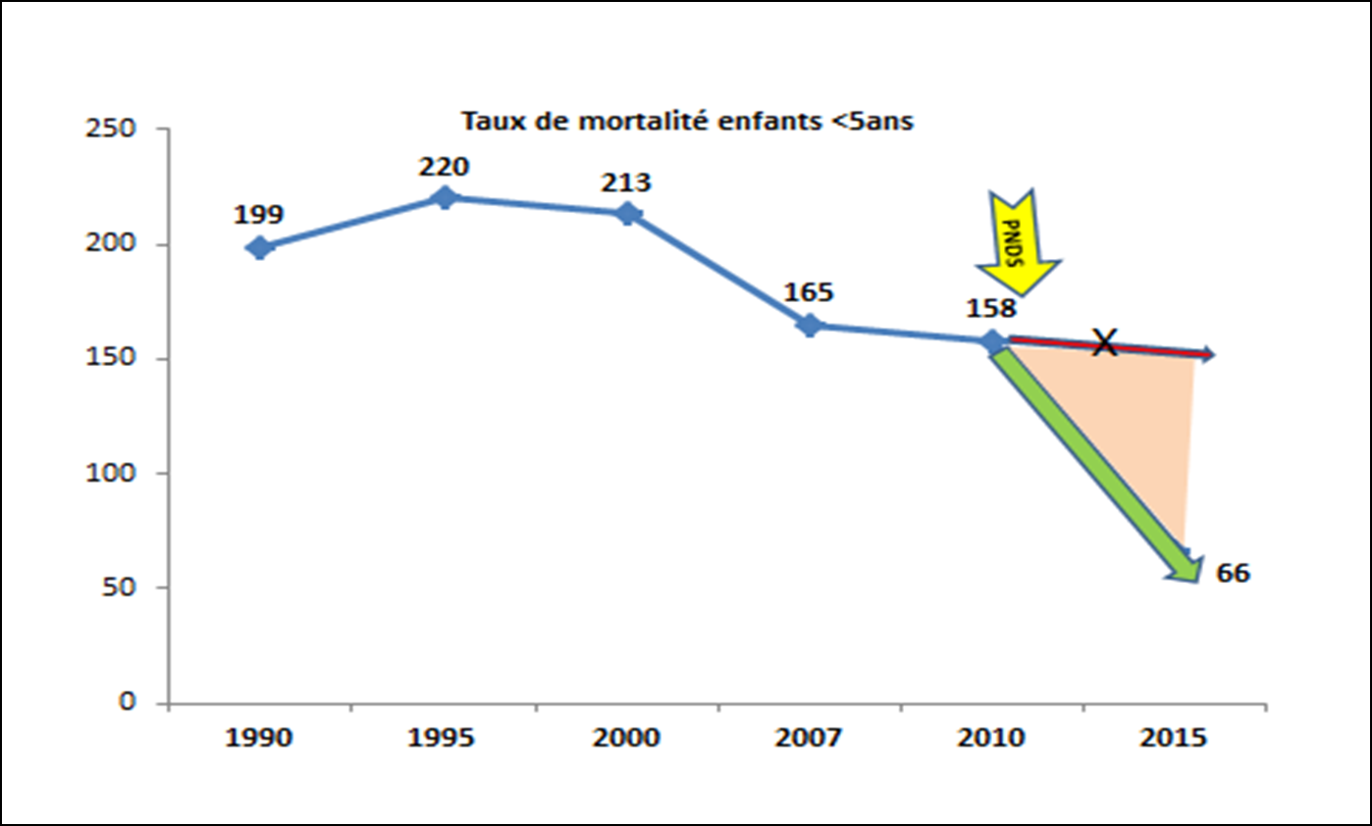
Some results: under 5 years mortality

Slide 11
Infant mortality by province

Slide 12
Conclusion
The implementation of the Paris D. has been helped by the SRSS, which is a product of the enhancement of the national institutional memory
The model consists in progressively developing the Health District according to the SRSS
The model is being replicated in other sectors
We can appreciate an improvement of service utilisation and of the health status of the population
Remaining challenges:
The structure of health financing at global level is still very vertical;
the shift from the humanitarian to the developmental approach among stakeholders takes time;
Reluctance was remarked among some partners in relation to the alignment to the on-going reforms;
The concept benefits form the support of all partners in the sector.

