Slide 1
Procurement is a hot topic!
So is Supply Management – but for today we will focus on procurement
IHP+ Country Health Sector Teams Meeting, Nairobi, Kenya 11-14 December 2012

Slide 2
Why Procurement? (and supply management)
no services without people, money and supplies

Slide 3
session objectives
To review the current level of utilization of national procurement mechanisms by development partners and explore the reasons why it is currently so low.
Report on the impact of the work of the IHP+ Working on Group Common Quality Assurance Guidelines towards harmonizing medicine procurement and consider the implications for the implementation of the recommendations of the Commission on Life Saving Commodities for Women’s and Children’s Health.
Consider the experience of the European Union countries in harmonizing national procurement systems, and its impact on their contribution as development partners.
Consider country perspectives on how aid effectiveness can be achieved through better alignment of procurement systems, and the main challenges to making it happen.

Slide 4
1. What does IHP+ Results tell us about the use of national procurement mechanisms by development partners?

Slide 5
IHP+ Results 2012
Countries need strong Public Financial Management Systems and strong Procurement Systems to ensure health financing is used to achieve health outcomes.
Very few data were available to measure the strength of country procurement systems.
Only 5 of 19 countries (Niger, Rwanda, Senegal, Sierra Leone and Uganda) underwent Procurement Systems assessments in 2011. All scored ‘level B’, the second highest of four possible ratings.

Slide 6
IHP+ Results 2012 findings suggest that the greatest need is for countries to strengthen Public Financial Management and Procurement systems and Development Partners to channel aid through these systems, to deliver more predictable Health Aid that is recorded on national budgets.

Slide 7
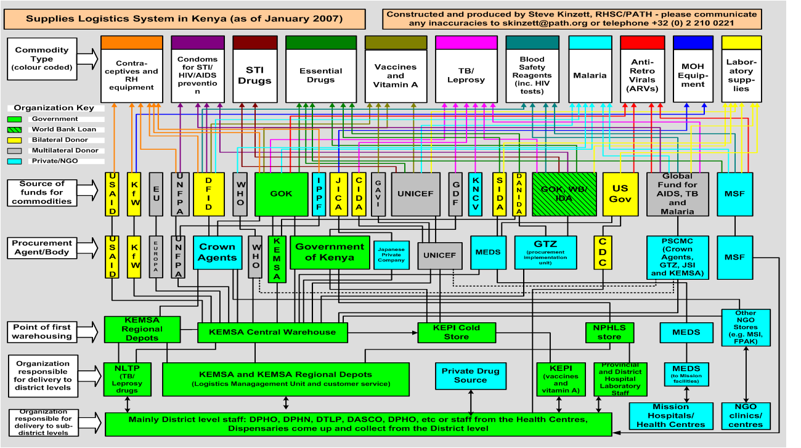
supply spaghetti at country level!

Slide 8
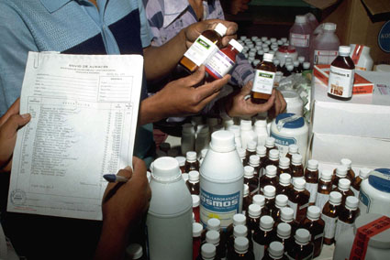
2009 review of Global Health Initiatives findings on supply management systems
Procurement and Distribution
Rapid improvements in availability and affordability of commodities
Strong GHI-owned systems duplicate and displace national supply chains
Quality
Improvements in quality through pre-qualification and agreement on global standards
Notes:
Crowding out – in e.g. Ethiopia, Mozambique, Uganda and Zambia.
Burden on workforce: especially in countries affected by the diseases the GHIs target. Including on workforce: HIV prevalence among Kenyan health workers is twice the national average
Brain-drain: In 2004, healthworkers in Zambia earned twice as much in the private sector than in the public sector
Parallel structures and poor coordination – duplication, waste

Slide 9
2. Report on the impact of the work of the IHP+ Working on Group Common Quality Assurance Guidelines towards harmonizing medicine procurement and consider the implications for the implementation of the recommendations of the Commission on Life Saving Commodities for Women’s and Children’s Health.

Slide 10
World Bank HNP Discussion Paper: Assuring the Quality of Essential Medicines Procured with Donor Funds and Draft Harmonized Assessment Tool based on the Model Quality Assurance System (MQAS)
The donor community spends millions of dollars annually on procuring essential medicines as part of development assistance for health. Defining and enforcing quality standards for these medicines continues to prove challenging as this involves complex regulatory processes.
While developed countries with stringent regulatory authorities in place have the capacity to comply with strict regulatory requirements, the essential medicines procured for developing countries are either not available in developed country markets, or are not the most competitively priced medicines internationally.
Donors have therefore been forced to independently develop systems to purchase at lowest feasible cost, essential medicines for the developing world without compromising quality.

Slide 11
In the long run, the goal of international donor aid is to build the capacity of developing countries to take the lead in assuring the health of their citizens.
Effective harmonization, coordination, and optimal leveraging of existing approaches may help national regulatory authorities to strengthen their own capacity to better control their markets, including registering products according to stringent standards, improving domestic manufacturing where applicable, and enhancing postmarketing surveillance.

Slide 12
Commission on Life Saving Commodities for Women and Children – Recommendations:
4. Quality strengthening: By 2015, at least three manufacturers per commodity are manufacturing and marketing quality-certified and affordable products.
5. Regulatory efficiency: By 2015, all EWEC countries have standardized and streamlined their registration requirements and assessment processes for the 13 live-saving commodities with support from stringent regulatory authorities, the World Health Organization and regional collaboration.
6. Supply and awareness: By 2015, all EWEC countries have improved the supply of life-saving commodities and build on information and communication technology (ICT) best practices for making these improvements.

Slide 13
3. Impact of European Union harmonization of procurement procedures

Slide 14
4. Country perspectives on how greater development effectiveness can be achieved through better alignment of procurement systems

Slide 15
key messages 1 + 2
Transparent and efficient procurement is critical to both service delivery and aid effectiveness and, therefore, to achieving better health outcomes with the resources available to health systems.
Bilateral and multilateral development partners have focused much of their efforts on 'upstream' strategic issues including identification of "best buys", strategic frameworks and SWAPS for resource allocation, and identification of technical interventions about "what works" in low resource community settings.

Slide 16
key messages 3 - 5
At country and sub-national level, concerns are likely to be focused on more basic issues, including the consequences of delayed or failed procurement. Poor procurement practices have many negative consequences. Drugs and equipment are often the second largest expenditure items after salaries, so if it fails there are significant knock on effects, including stock outs and the purchase of substandard or counterfeit goods. Procurement is also a major target of corruption.
Countries and their donor partners can both do more to align their procurement systems – but without a global standard many donor partners will be constrained by their own legally enforced systems.
Short of total alignment, a constructive and pragmatic approach would take us a long way.

Slide 17
Proactive role in strengthening PSM system
Comprehensive SYSTEMIC approach
Cooperative efforts from UNICEF PD/SD/ RO/CO in system strengthening
Ensure coordination mechanisms and development of partnerships around PSM
Direct supply
Strengthening National PSM System
PSM in UNICEF programmes
Notes:
Starting on the lower left:
UNICEF cant do it on its own. In fact UNICEF is and will be more of a convener at country level, than an implementer. However when we are an implementer it seems we do make a positive change and impact., but the implementer role takes quite specific conditions to actually happen.
Overall we have a good position to raise the topic , to advocate but also a good position to influence, what we already do, to be more comprehensive, when relevant,.
If one is mainly doing direct delivery then one need to consider how to have impact over time on systems – also from the direct delivery mode. and ways of making these more sustainable t and o moving beyond to systems work, if relevant

Slide 18
WHAT?
Govts
CSOs
Principles
Rational
Use
Formulation
HR
Legal
Framework
Country
Office
Access
Supply
System
Financing
Research
Cost
Containment
Reg. Office Programme & Supply Division
Partner organization
Notes:
System strengthening and enabling supply goes way beyond basic supply chain management and must include considerations linked to good governance, incentive structures, human resource management, legal frameworks etc.
Our Country Offices are on the for front handling such potentially complex PSM support requests and are focal ,and in the lead, when it is decided to engage in system strengthening projects.

Slide 19
Why?
Enabling PSM
Supply of Essential Commodities for Children & Women
National PSM Systems Strengthening
Universal access
ACSD
Sustainability
High impact on morbidity and mortality
Achieving the MDGs with Equity
Notes:
Why – for sustainability. Can we get a bigger overlap of the two circles – in which countries?
It has been demonstrated that the key ingredient in building sustainability is political will both on part of the Govt. as well as UNICEF CO and partner organizations.

Slide 20
HOW?
ENABLING PSM
MONITORING
Essential Commodities for Children & Women
STRENGTHENING
National PSM Systems
For E.C.
Health/Nutrition/HIV
Education
WASH
Protection
Emergency
Access
Quality
Affordability
Adequate use
‘INTERNAL WORK’
‘EXTERNAL WORK’
SitAn (Situation analysis) including
ECA (Essential Commodities Assessment)
Support to national PSM
Systems & Partnerships
CPD/CPAP
UNDAF/UNDAP
National Policies & Budget, (PRSPs, SWAPs, MTEFs, etc.)
Notes:
Have we reviewed and exploited potential operating synergies? Enabling Procurement & Supply Management can: - Improve service continuity; -
Reduce overall cost of handling and storage and transportation cost and -
Reduce obsolete material
It is generally acknowledged that system strengthening, capacity building and enabling supply is a complex journey and it is clear we can not do this alone - we need to work with partners on many levels.
Do we need to be more strategic in our partnership collaboration in the PSM area? Are there ways on influencing vertical funding streams to be addressing critical issues for children broadly – e.g. What can we do to ensure that all project proposal that come across our desk has been reviewed in terms of - is there a need for PSM – and if so has this been included in the proposal?
UNICEF CO role is very much to monitor access to Essential Commodities for Children & Women – with that basis - informed decision can be made on what are the gaps and this should be included in the country office planning and with govt. and other partners strategic plans, fundraising etc can flow.
Reaching the MDGs using the approach of going to the weakest communities first, with the minimum package of high impact interventions is a mode for pursuing equity. We have reviewed barriers to access on the ground and know that we might will continue

Slide 21
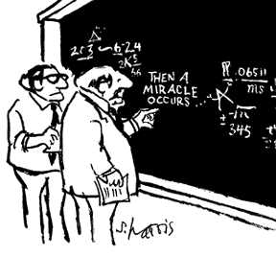
“I think you should be a bit more explicit here in step two.”
Science Cartoons Plus (S Harris)

