Slide 1
REPUBLIC OF BENIN ------------ Fraternity- Justice- Work ------------
MINISTRY OF HEALTH
Is the development of Performance-Based Funding (PBF) in Benin helping to make international cooperation more effective?
5e réunion IHP+ des équipes chargées du secteur de la santé dans les pays
2-5 décembre 2014
Sokha Angkor Resort, Siem Reap, Cambodia

Slide 2
Five key questions to be answered
Which development partners are granting or intend to grant PBF in Benin?
Do they use the same indicators and targets to measure performance and the same system of preparing reports? Are these indicators and targets drawn from your national health plan?
How did you get the World Bank, the Global Fund and GAVI to use the same PBF methods and indicators?
Is PBF helping to harmonise international support and make it more effective?
What barriers does PBF represent for effective cooperation? For example, if there are multiple verification systems, is managing them a burden?

Slide 3
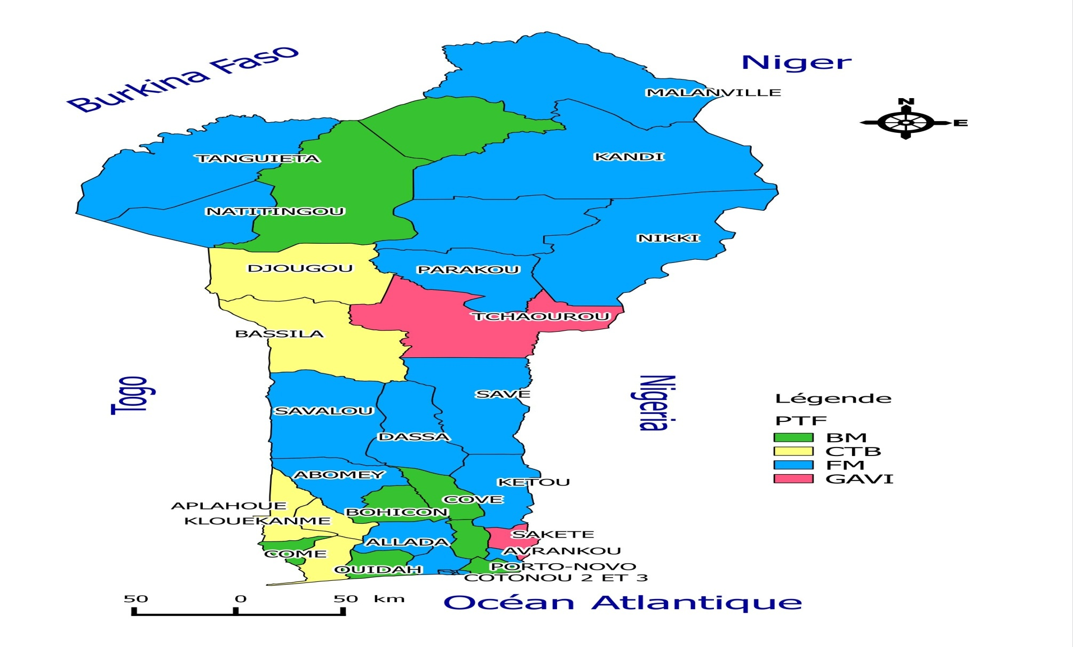
1. Which development partners are granting or intend to grant PBF in Benin
World Bank: USD 43.8 million of which USD 20.7 million for PBF (8 health areas out of 34) for 4 years
Global Fund: 25,661 million Euros over three years, 19 health areas
GAVI: USD 8,375 million of which USD 5,759 million for PBF for 5 years with 2 areas
CTB: 20 million Euros over five years of which 2,410 million Euros for PBF for 5 health areas
Scale-up: 1st quarter 2015

Slide 4
2. Do they use the same indicators and targets to measure performance and the same system of preparing reports? Are these indicators and targets drawn from your national health plan?
Basic document for PBF: Framework of PBF in Benin, January 2014 version, setting out the rules governing PBF, notably the indicators/targets of the programme, the distribution of the PBF budget, the unit costs of services, the methods for calculating credits and allocation, verification and secondary verification procedure, role of stakeholders etc (www.beninfbr.org), is currently being used in 8 health areas (WB) and will be used in 21 health areas (GAVI and GF) by the end of the 1st quarter of 2015, funding available
Harmonisation of indicators in progress with 5 health areas (CTB) for use of the same framework
Indicators and targets drawn from the National Health Development Plan and based on MDGs 4,5 and 6

Slide 5
3. How did you get the World Bank, the Global Fund and GAVI to use the same PBF methods and indicators?
COUNTRY COMPACT agreed in November 2010 and implementation of joint HSS “Health System Strengthening” platform between the Technical and Financial Partners (TFP) and the Government of Benin, the Global Fund, the Vaccine Alliance (GAVI), the Coopération Technique Belge (CTB), facilitated by WHO
The goal of the HSS platform is to implement the Country Compact: harmonisation of strategies implemented with a single management unit, one monitoring-evaluation mechanism with the support of the Technical and Financial Partners under the leadership of the Ministry of Health
Implementation: agreement of stakeholders to continue with the PBF strategy with an adjustment of the system implemented according to the project negotiated by Benin with the World Bank (March 2010), having a component supporting a “sector-based approach”.

Slide 6
4. Is PBF helping to harmonise international support and make it more effective?
First results obtained in the health areas supported by the World Bank with PBF
Transition from a “Project” financed by a single TFP to a “Health System Strengthening (HSS)” platform/programme, with other technical and financial partners besides the World Bank, with WHO facilitation
Country compact: opportunity to bolster the HSS platform to better document and ensure mutual accountability
Results: increase in funding, respect of principles of the Paris Declaration, support for the national PBF policy with a single system of planning, coordination and monitoring/evaluation

Slide 7
5. What barriers does PBF represent for effective cooperation? For example, if there are multiple verification systems, is managing them a burden?
Consensus in implementation in health centres/hospitals and community-based organisation applicable in 29 health areas out of 34, harmonisation under way to integrate the 5 areas of the CTB
Integration of community links into the system is facing resistance from the traditional TFPs in this area (change in approach regarding PBF on indicators to be bought)
PBF in private sector under way but negotiation with traditional TFP

