Slide 1
Financial Management Harmonization and Alignment
Prepared by Renaud Seligmann, Chair, IHP+ FM TWG, Max Dapaah & Finn Schleimann
Presented by Finn Schleimann, IHP+ Core Team,
IHP+ CHTM, Siem Reap December 2014

Slide 2
Definitions and focus areas of IHP+ FM Harmonization and Alignment
Alignment – achieved through the use of country financial management (FM) systems
Harmonization – achieved either through the use of some aspects of FM country systems and parallel arrangements agreed upon by DPs and government, or parallel arrangement alone, where none of the aspects of country systems cannot be used
One financial statement for the health sector
One audit report for the health sector
Joint FM supervision

Slide 3
Key principles of FM harmonization and alignment
Align with country systems whenever they meet the minimum acceptable level.
Harmonize among development partners, when all or part of the national Public Financial Management (PFM) system is not sufficiently developed
Do things jointly: Joint FM Assessment, joint action plan for strengthening the system and joint supervision
Not wait until all problems have been solved, but use elements of country systems as part of the process of improving systems and developing capacity

Slide 4
Fiduciary objectives in the health sector
Funds need to be channeled to the health sector (right amount, right place, right time)
These funds need to be spent for intended purposes, with value-for-money
Stakeholders (MoF & donors) need a reasonable assurance on intended purpose and value-for-money
Problem: if each donor sets up its own FM arrangements, there are unintended consequences for the whole system

Slide 5
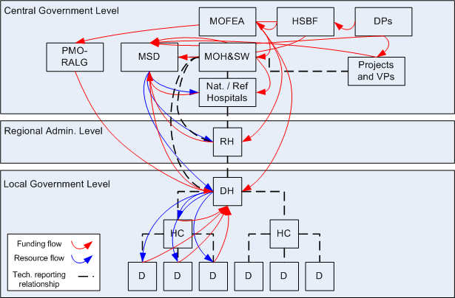
Fund flow and reporting relationships are inherently complex in the health sector
Source: Parminder Brar, WB

Slide 6
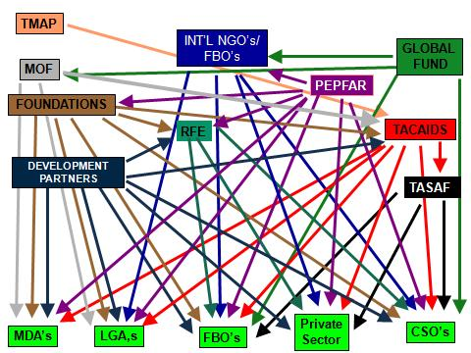
But the addition of a plethora of FM arrangements for donor funding brings the complexity to a whole new level
Source: Parminder Brar, WB

Slide 7
Beyond fiduciary concerns, FM matters for health development outcomes
Funds need to be channeled to the health sector (right amount, right place, right time). Good sector plans and budget are fundamental to achieving this
These funds need to be spent for intended purposes, with value-for-money and accounted for accurately using reliable financial accounting systems
Stakeholders (government, parliament, donors) need a reasonable assurance on intended purpose and value-for-money through external audit (financial and VofA)
Problem: when PFM system is weak, and no harmonization exist among DPs, health system outputs and outcomes are affected

Slide 8
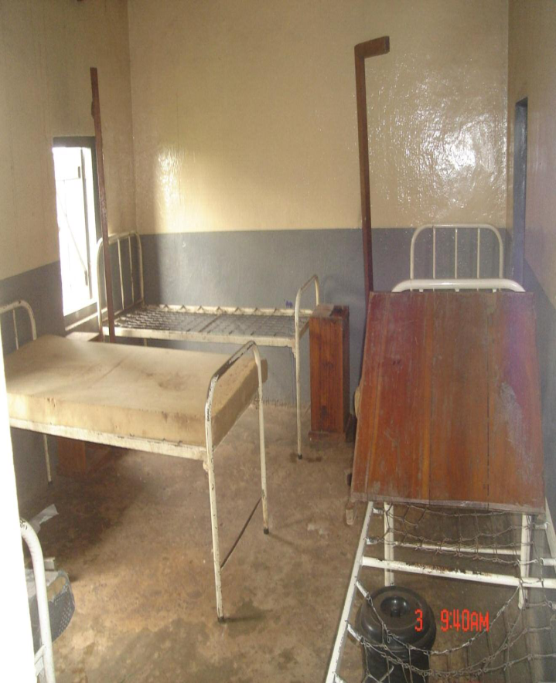
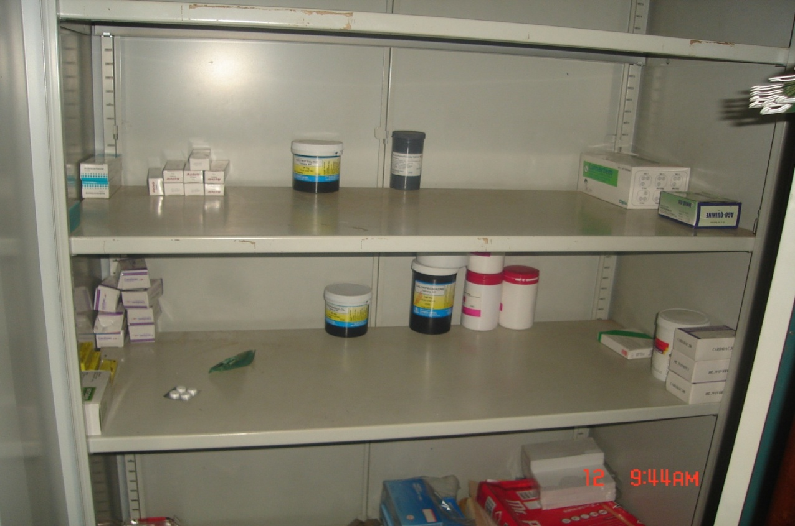
What happens when PFM systems are weak
Notes:
8

Slide 9
When DPs harmonize or align with country system what happens?
There are mutual benefits to both DPs and Country Partner:
Funders use the same budget and accounting system -> managers have the budget overview needed -> resources allocated against key priorities
One common budgeting and reporting system -> transaction cost reduced -> time freed up to deliver services
Single audit of all donor and government funds -> more efficient audit -> inefficiencies and misuse identified
Joint capacity building also strengthen efficiency and accountability

Slide 10
Why is there not more happening on FM systems harmonization and alignment in the health sector?
Benefits of the current arrangements are high for vested interests – complexity breeds confusion; facilitates double-dipping, fraud and misleading reporting
Costs of current FM arrangements are largely borne by MoH and patients whereas costs of change would be mostly incurred by development partners, PIUs and private sector audit firms
Weak demand for accountability from some stakeholders (parliament, media, civil society)
Complex relationships between MoF, MoH and DPs is not conducive to change (health vs PFM specialists)
There is a perception that alignment is inherently more risky than stand-alone FM arrangements
There s the perception that harmonization is only possible under pool fund or SWAp support

Slide 11
What can be done?
Development Partners
Forge in-country collaboration to periodically discuss common FM issues
Harmonize, and where possible align with country systems by working jointly with country partner
Support strengthening of country systems
Country Partners
Develop ‘one plan and one budget’ for health sector as foundation
Minimize the incentives for fragmentation among DPs through strengthening of country systems
Encourage DPs to harmonize, where country systems are not in a state of readiness for alignment
Contact IHP+ for support on FM harmonization and alignment

Slide 12
Financial Management Harmonization and Alignment:
It’s All About Results
''Financial management in the health sector is a sacred responsibility because it ensures the health of the people“, Minister of Finance, Sierra Leone
"You cannot have a reform of public health without reform in finance management”, Permanent Secretary, Ministry of Finance, Rwanda

