Slide 1
Development cooperation after 2015: what role for IHP+? Brenda Killen Development Co-operation Directorate OECD
Notes:
What do we know about the post-2015 agenda, what do we know about the changing nature of development cooperation, and what does this mean for health?

Slide 2
What do we know about the post-2015 agenda?
Broader in scope:
Three pillars of sustainable development: economic , social, environmental
Universal goals for all countries
Global public goods as well as national development challenges
More ambitious vision:
Zero-based goals: e.g. ending poverty and hunger
More holistic vision, focused on overall development outcomes
Every success will make the remaining mission harder to achieve
Goals will act as a global social floor
Notes:
Successor framework will be much more complex and ambitious than the MDGs
Universality: signals transition away from the North-South dynamic that has defined development policy for decades.
Though the specifics are still unclear – in particular how best to accommodate varying national circumstances and contexts – the basic idea is that every country would have work to do, both at home and as members of the global community, in order to achieve the post-2015 development agenda.

Slide 3
… more complex process!
Notes:
Multiple components, overlapping processes: Open Working Group, ongoing work on indicators, financing for development, High-Level Political Forum, etc. Links with other processes, particularly UNFCCC.

Slide 4
SUSTAINABLE DEVELOPMENT GOALS
GOAL 1 | End poverty in all its forms everywhere
GOAL 2 | End hunger, achieve food security and improved nutrition and promote sustainable agriculture
GOAL 3 | Ensure healthy lives and promote well-being for all at all ages
GOAL 4 | Ensure inclusive and equitable quality education and promote lifelong learning opportunities for all
GOAL 5 | Achieve gender equality and empower all women and girls
GOAL 6 | Ensure availability and sustainable management of water and sanitation for all
GOAL 7 | Ensure access to affordable, reliable, sustainable and modern energy for all
GOAL 8 | Promote sustained, inclusive and sustainable economic growth, full and productive employment and decent work for all
GOAL 9 | Build resilient infrastructure, promote inclusive and sustainable industrialization and foster innovation
GOAL 10 | Reduce inequality within and among countries
GOAL 11 | Make cities and human settlements inclusive, safe, resilient and sustainable
GOAL 12 | Ensure sustainable consumption and production patterns
GOAL 13 | Take urgent action to combat climate change and its impacts*
GOAL 14 | Conserve and sustainably use the oceans, seas and marine resources for sustainable development
GOAL 15 | Protect, restore and promote sustainable use of terrestrial ecosystems, sustainably manage forests, combat desertification, and halt and reverse land degradation and halt biodiversity loss
GOAL 16 | Promote peaceful and inclusive societies for sustainable development, provide access to justice for all and build effective, accountable and inclusive institutions at all levels
GOAL 17 | Strengthen the means of implementation and revitalize the global partnership for sustainable development
Notes:
OWG proposed 17 goals, 169 targets.
Consultative process, covering many contentious issues, OWG proposal represents fragile consensus but big decisions remain. They barely fit on a slide but pessimism about whether it will be possible to slim it down further.

Slide 5
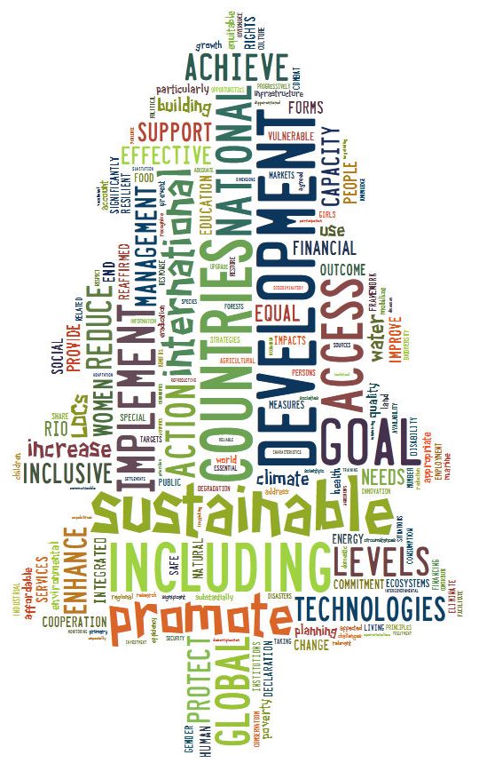
SUSTAINABLE DEVELOPMENT GOALS
Notes:
OWG proposed 17 goals, 169 targets: Christmas tree? Or, as Charles Kenny said, a plantation of Christmas trees?

Slide 6
More focus on implementation and accountability
Not just about goals: the September 2015 summit will adopt an entire package:
Political declaration;
Sustainable Development Goals, targets and indicators;
Means of Implementation and a new Global Partnership;
Framework for monitoring and review of implementation.
This is where attention will increasingly turn over the next several months: to the how of the post-2015 framework in addition to the what.
Notes:
More focus on implementation and accountability – OWG proposed targets on means of implementation related to each goal, as well as a separate goal.

Slide 7
What will it take to deliver the post-2015 framework?
Financing – development and climate – will be critical, but not sufficient
New actors and instruments, new financing landscape
Other means of implementation: trade, technology transfer, technical advice, policy support, etc.
Focus on inclusive growth
Partnerships and coalitions
Notes:
Would like to focus on the development finance picture, which is where the OECD DAC has the biggest role.

Slide 8
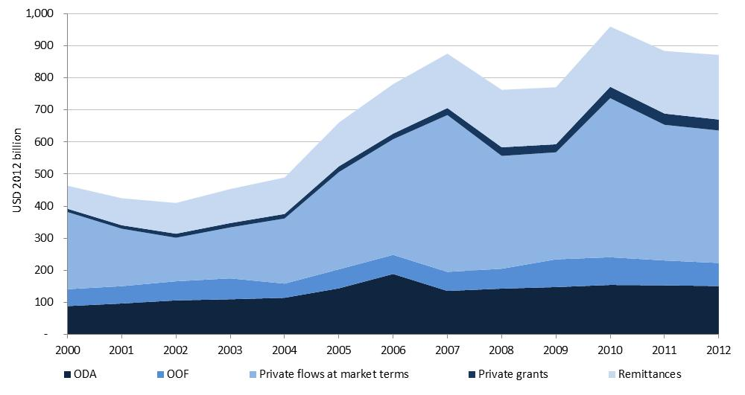
Today’s development finance landscape
More diversification and changing relative importance of financial flows to developing countries
Notes:
Today’s picture: there is more diversity of funding than even just a decade ago, offering developing countries a wider array of options to choose from, with large potential benefits for their development.
This figure shows the change in the composition of external flows to developing countries since 2000.
New and growing sources of finance have emerged or become more prominent: from foreign, portfolio and institutional investors; workers’ remittances; philanthropic institutions; and emerging and re-emerging donors. ODA from DAC members remains an important source of finance for many developing countries (it has increased by 63% in real terms the past ten years), BUT non-concessional flows, both official and private, play an increasingly important role in developing countries.
While ODA is still the main source of development finance for many countries, at the aggregate level the relative importance of ODA as a source of finance has progressively diminished. Non-concessional flows, both official and private, play an increasingly important role in developing countries.

Slide 9
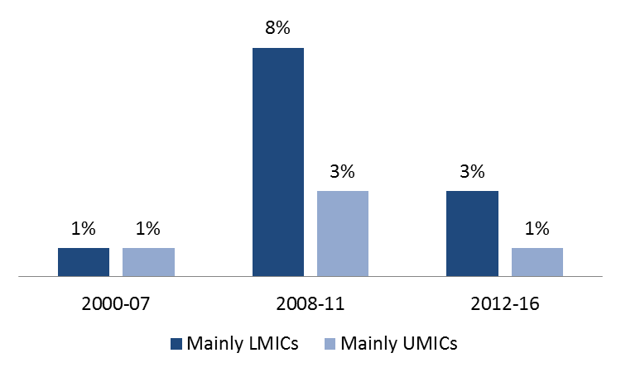
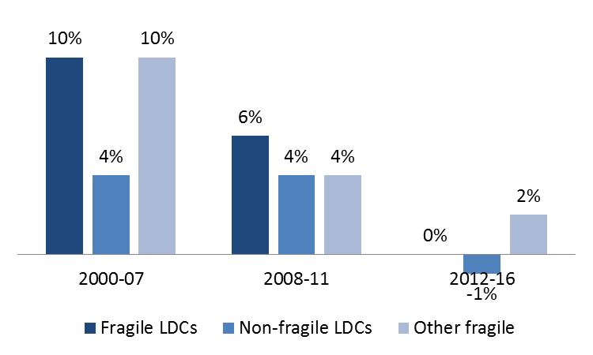
Today’s development finance landscape
Recipients: reliance on ODA varies across developing countries and those most in need are starting to receive less ODA
Composition of external finance in LDCs and other countries, 2012
ODA growth is accelerating for MICs..
…but not for LDCs and fragile states
Notes:
Despite the availability of new and old sources of finance to developing countries, these sources are not equally accessible to all.
Access to a more diverse range of sources of finance has increased mainly for middle-income countries, while LDCs remain highly reliant on ODA as the key source of external finance for development. In 2012, ODA represented 68% of total external finance for development in LDCs, whereas it represented 20% in Lower Middle Income Countries (LMICs) and 6% in Upper Middle Income Countries (UMICs) respectively.
Bottom line: ODA continues to matter most in the poorest and most fragile countries, but there are large imbalances across countries and ODA is not always reaching the poorest people

Slide 10
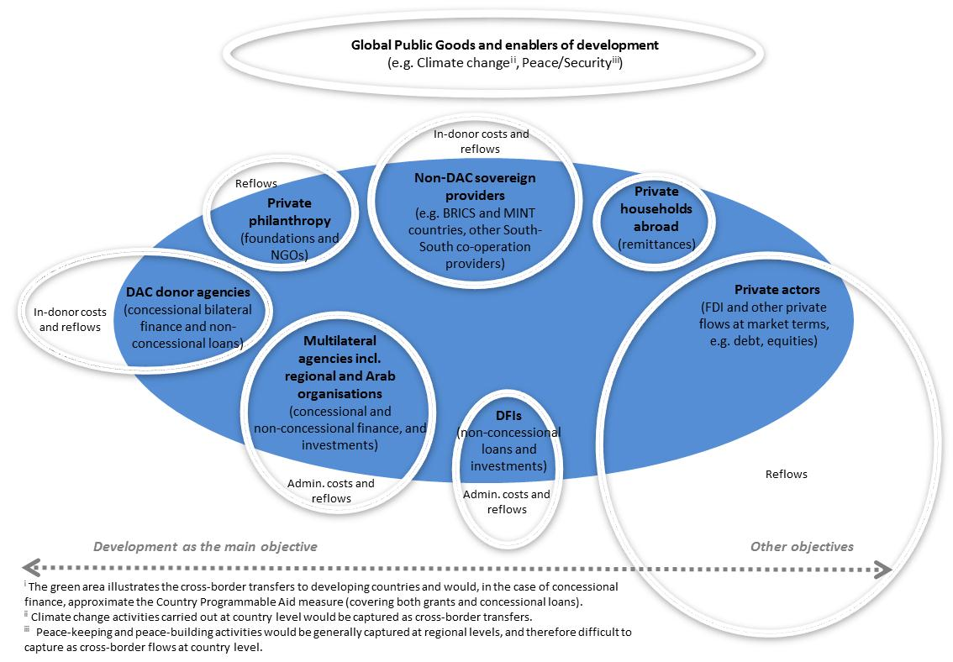
Today’s development finance landscape
New actors and instruments
Notes:
Landscape is populated today by many more actors.
Also, not shown here: one of the biggest changes has been developing country leadership over aid management and coordination
Development cooperation providers forced to reconsider their role and value added; focus on quality of development assistance: but actions still need to live up to rhetorical commitments

Slide 11
Ensuring the right incentives
Work to assess and measure resources beyond ODA should not be used by donors to back away from existing commitments, including the U.N. target of 0.7% ODA/GNI
ODA is critically important going forward, especially for LDCs and fragile states (reverse the downward trend of ODA to LDCs)
Effectively contribute to transparency and accountability for the monitoring of the post-2015 development agenda
In more complex financing landscape, how do we protect the role of aid and make sure it is focused on what it does best?
Notes:
We can only achieve successfully a modernisaiton of our framework, as long as we maintain our commitment of reaching a 0.7% of ODA to GNI alongside with reversing the downward trend of ODA to LDCs.
DAC donor countries’ performance against the UN ODA target of 0.15-0.20% of GNI to LDCs, the DAC as a whole still falls short of the target.
What we also want to achieve is measurement system that carries the right incentives.

Slide 12
OECD DAC modernisation agenda
Reflect broadening of the global development agenda
Reflect the new complexity of development finance (actors/instruments)
Acknowledge increased diversity of developing countries and provide the right incentives for ODA allocations
Promote international standards for measuring and monitoring the means of the implementation of the SDGs
Increase transparency and accountability of development finance
Goal: maximise overall resource envelope available and make the best of public money for development
Notes:
Need to provide incentives to maximise the overall resource envelope available for sustainable development (e.g. encourage the use of market-like instruments when appropriate, work on investment climate, importance of DRM).

Slide 13
Partnerships
Inclusive coalitions – multi-stakeholder initiatives, more partnerships with private sector
Shift from ‘implementers to enablers’
The landscape for cooperation is becoming more complex – but this offers more opportunities to get the right type of support.
OECD hosts various partnerships: International Dialogue on Peacebuilding and Statebuilding, Effective Institutions Platform, PARIS21
Global Partnership for Effective Development Co-operation: ‘partnerships hub’ for a range of initiatives, including IHP+

Slide 14
So what have we learned?
Post-2015 framework will be more ambitious, requiring more integrated, holistic responses, which will need to be delivered in a more complex landscape.
This tracks with what we’ve learned in health: successful health systems are essential for delivering improved outcomes on overall health and mortality.
No substitute for effective public institutions in protecting the public interest. This means investments in capacity, but also in building trust between state and society.

Slide 15
Ebola: failure to invest in health systems
Notes:
Ebola: successful containment in Nigeria was intensive but low-tech: contact tracing, 18,000 home visits to 898 people.

Slide 16
What does this mean for IHP+?
Notes:
Good news: IHP+ is precisely the kind of partnership that will be needed to deliver the ambition of the SDGs

Slide 17
What does this mean for IHP+?
Developing countries want more policy support to promote inclusive growth, market-like approaches
The seven behaviours – and the Busan principles – are even more important in this context.
Does IHP+ need to re-introduce itself to explain what it brings to the equation to help guide countries, systems, and communities to manage this complexity?

Slide 18
Thank you

Slide 19
Some Additional Slides

Slide 20
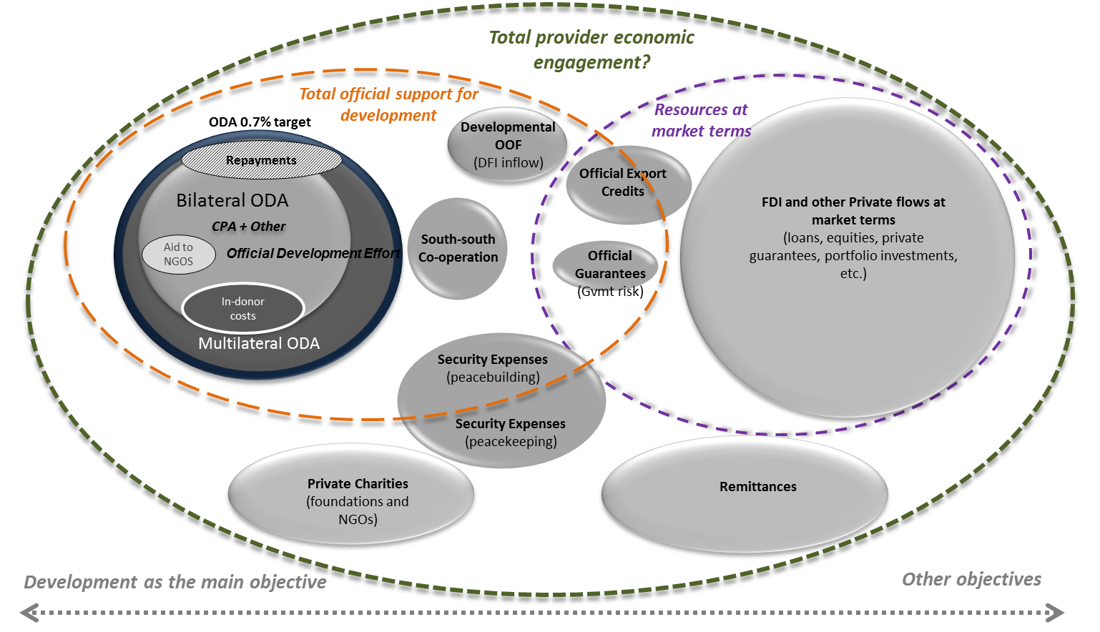
External development finance: emerging financial concepts - provider’s perspective
Notes:
And this is the provider’s prospective of development co-operation. You’ve got a small circle of bilateral ODA, CPA + other, and ODE is emerging….
You’ve got a slightly wider circle of ODA which includes our contributions to the World Bank, the UN system and other multilaterals.
Then, you’ve got a slightly wider circle again which we could call official support for development which, of course, includes a series of other expenses, some from us, clearly also includes flows from southern providers where we have less information about the terms, it clearly includes guarantees.
And then, you have an even wider circle which is the total economic engagement of countries, where private flows from companies, where remittances from citizens from developing countries living in DAC countries, where private charity and so on will all be part of a larger national effort of countries.
And maybe it is useful if we go back in history: the origin of the 0.7% target is actually a subset of 1.0% target for total net resource flows to developing countries, set at the Eleventh Meeting of the World Council of Churches. “Resource flows” meant that the target included private investment, so a broader national effort, so, in a way, we’re coming back to the roots.
Including private investment within the one per cent target made it easier to meet, but impossible to target, since governments have little or no control over the level of private investment. And today other flows are much larger than ODA.

Slide 21
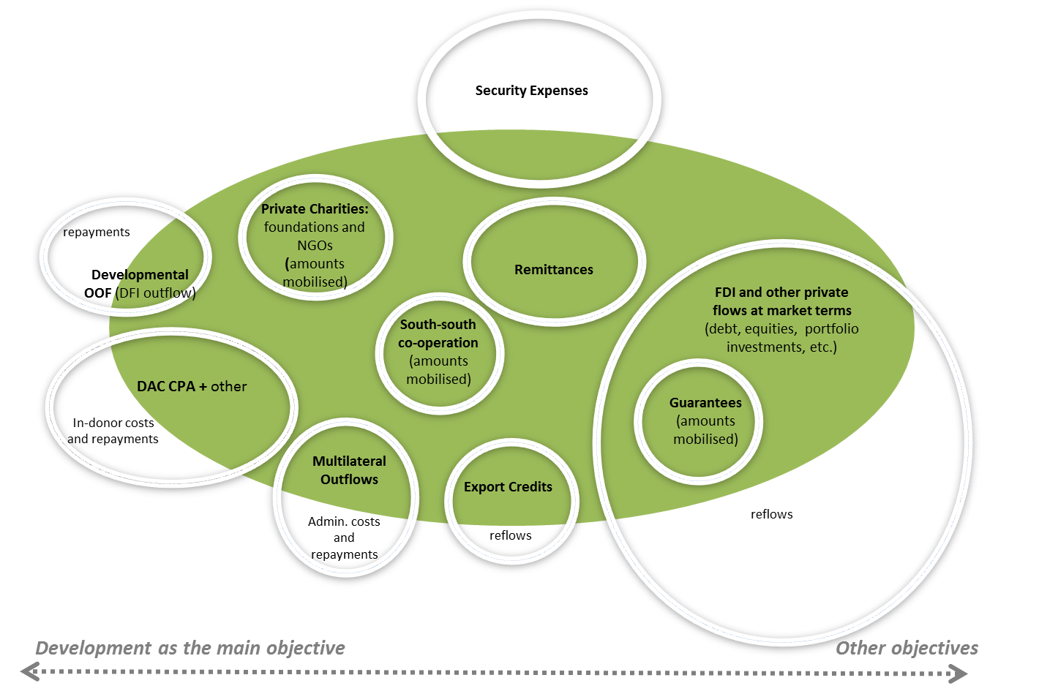
External development finance: emerging financial concepts - recipient country’s perspective
Notes:
If we look at the same picture from a recipient perspective, it looks slightly different.
For partner countries, it may be important but it may not be that important whether the intention of the donor is primarily developmental or not.
They may be more interested in the totality of the resources that they get, whether it is with a strictly development purpose or more of a commercial purpose.
And you’ll see there is a big security expense where a small part is developmental, a larger part results in flows to developing countries, the biggest part to the extended results in flows is flows of soldiers and not flows of funds.
I show this not as a final product because these are not final products but just to illustrate the way we are thinking and our work is evolving.
WHAT ARE OOF:
Other official flows are official sector transactions which do not meet the ODA criteria, e.g.: i.) Grants to developing countries for representational or essentially commercial purposes; ii.) Official bilateral transactions intended to promote development but having a grant element of less than 25 per cent; iii.) Official bilateral transactions, whatever their grant element, that are primarily export-facilitating in purpose. This category category includes by definition export credits. This category includes by definition export credits extended directly to an aid recipient by an official agency or institution ("official direct export credits"); iv.) The net acquisition by governments and central monetary institutions of securities issued by multilateral development banks at market terms; v.) Subsidies (grants) to the private sector to soften its credits to developing countries [see Annex 3, paragraph A3.5.iv)b)]; vi.) Funds in support of private investment. Data coverage starts in 1960

Slide 22
Ebola: unprecedented crisis
Notes:
Extra Ebola slides

Slide 23
Jim Kim on Ebola
“[We] must act on the knowledge that weak public health infrastructure, institutions, and systems in many fragile countries are a threat not only to their own citizens but also to their trading partners and the world at large. The enormous economic cost of the current outbreak to the affected countries and the world could have been avoided by prudent ongoing investment in health systems-strengthening.’’

