Slide 1
The IHP+ Financial Management Technical Working Group
Renaud Seligmann, Sector Manager, World Bank
Chair, FM TWG

Slide 2
Contents
Fiduciary objectives of development partners in the health sector
Links between PFM and development objectives in the health sector
Bottlenecks to FM harmonization and alignment in the health sector
Next steps – changing FM behaviors in the health sector

Slide 3
Fiduciary objectives of Development Partners in the health sector
Funds need to be channeled to the health sector (right amount, right place, right time)
These funds need to be spent for intended purposes, with value-for-money
Development partners need a reasonable assurance on intended purpose and value-for-money
Problem: if each DP sets up its own FM arrangements, there are unintended consequences that affect the whole system

Slide 4
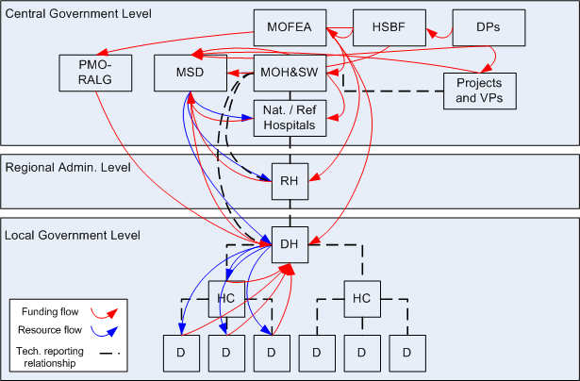
Fund flows and reporting relationships are inherently complex in the health sector
Source: Parminder Brar, WB

Slide 5
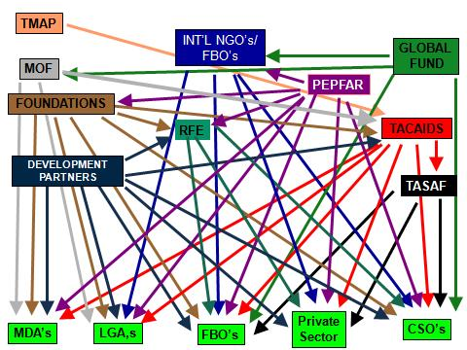
The plethora of FM arrangements for development partner funding adds another layer of complexity
Creates very high transaction costs
Increases overall fiduciary risks
Prevents overall system strengthening
Source: Parminder Brar, WB

Slide 6
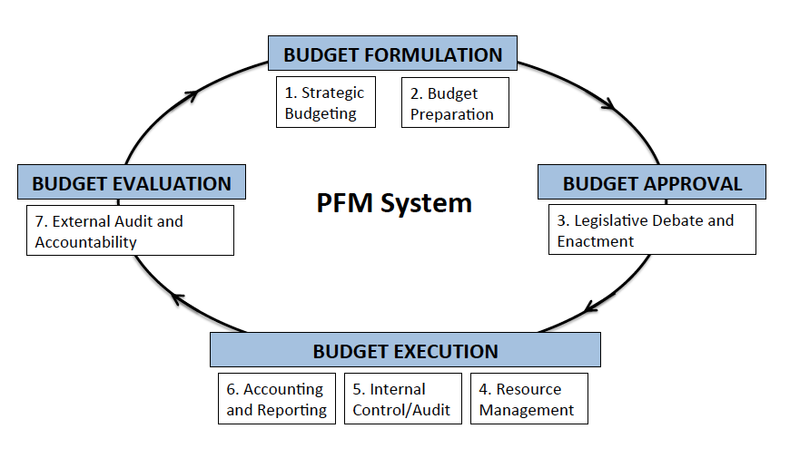
PFM matters for health development outcomes
Financial and performance audits of the health sector
Parliamentary oversight
Allocation to health sector – volume, recurrent vs capital, geographic location, fit with sector strategies
Timely fund flows
Value for Money in Procurement of vaccines, pharmaceuticals, medical equipment and buildings.
Asset management
Comprehensiveness
Accuracy
Timeliness of financial reporting
Controls over cash,
assets and payroll
Effectiveness of health sector internal audit
Source: Andrews, Cangiano, Cole, Krause, Seligmann, This is PFM, forthcoming (2014)

Slide 7
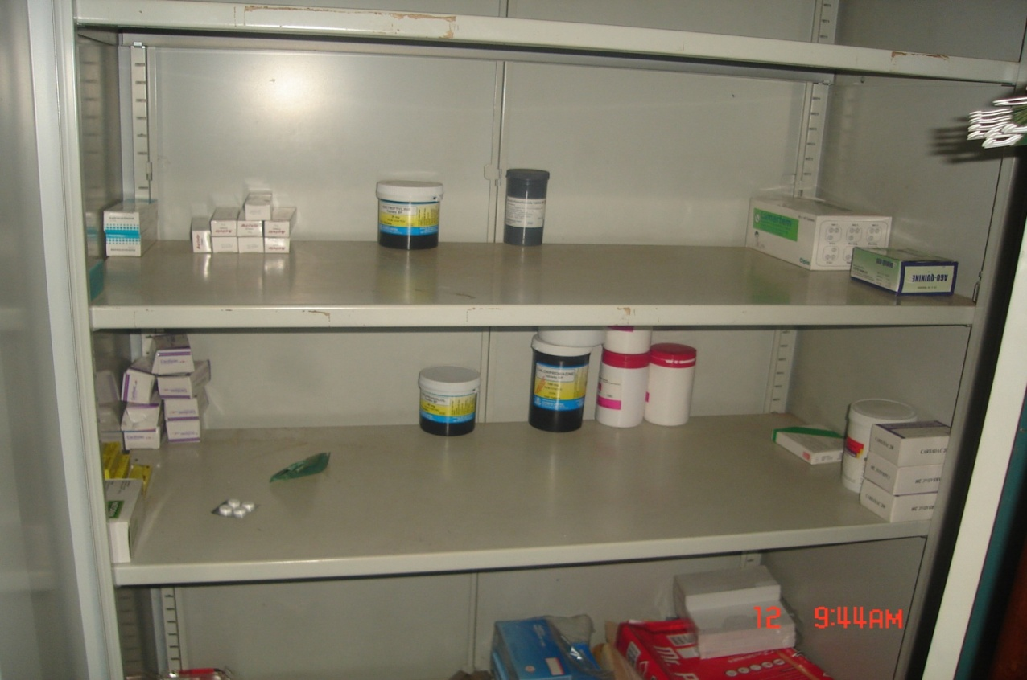
What happens when PFM systems are weak
Notes:
7

Slide 8
So, what to do?
Harmonize FM arrangements
Strengthen country FM systems
Align with country systems

Slide 9
Bottlenecks to FM harmonization and alignment in the health sector
Benefits of the current arrangements are high for rent-seekers – complexity breeds confusion; facilitates double-dipping, fraud and misleading reporting
Weak demand for accountability from some stakeholders (executive, parliament, media, civil society…)
Triangular relationships between MoF, MoH and DPs is not conducive to change (health vs PFM specialists)
There is a perception that alignment is inherently more risky than stand-alone FM arrangements – this is not based on fact and evidence
Costs of current FM arrangements are largely borne by MoH, MoF and patients whereas costs of change would be mostly incurred by development partners, PIUs and private sector audit firms

Slide 10
Changing behaviors on FM in the health sector
Demand Side
Supply side
Make a strong business case for change through analytical work
Facilitate enhanced in-country dialogue between MoHs, MoFs and civil society on the importance of PFM for service delivery in health
Foster DP dialogue on Health Sector FM harmonization and alignment.
Formalize protocol for information sharing among DPs
Disseminate work already undertaken on FM harmonization and alignment
Scale-up joint in-country engagement, in response to country and DP demands

Slide 11
Thank you for your attention
rseligmann@worldbank.org

